Slide 1
Lord have mercy
5 Songs of Faith Composed by Simon Schmidt (2013)

Slide 5
Lord have mercy
5 Songs of Faith Composed by Simon Schmidt (2013)

Slide 9
Glory to God
5 Songs of Faith Composed by Simon Schmidt (2013)

Slide 20
Glory to God
5 Songs of Faith Composed by Simon Schmidt (2013)

Slide 31
Holy Holy
5 Songs of Faith Composed by Simon Schmidt (2013)

Slide 36
Holy Holy
5 Songs of Faith Composed by Simon Schmidt (2013)

Slide 37
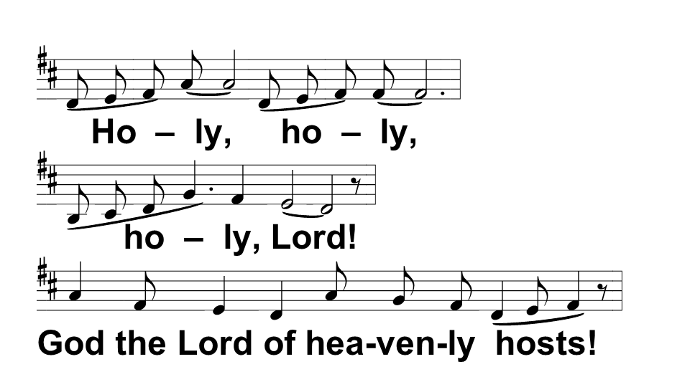

Slide 41
Lamb of God
5 Songs of Faith Composed by Simon Schmidt (2013)

Slide 45
Lamb of God
5 Songs of Faith Composed by Simon Schmidt (2013)

Slide 49
Song of Simeon
5 Songs of Faith Composed by Simon Schmidt (2013)

Slide 54
Song of Simeon
5 Songs of Faith Composed by Simon Schmidt (2013)

