Slide 1
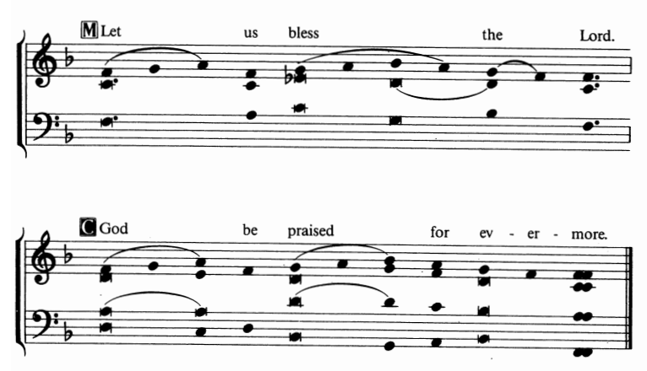
Let us bless the Lord

