Slide 1
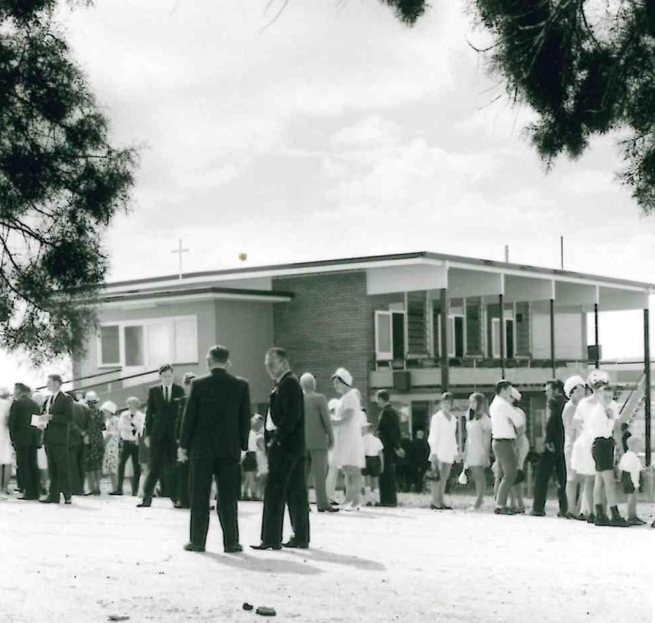
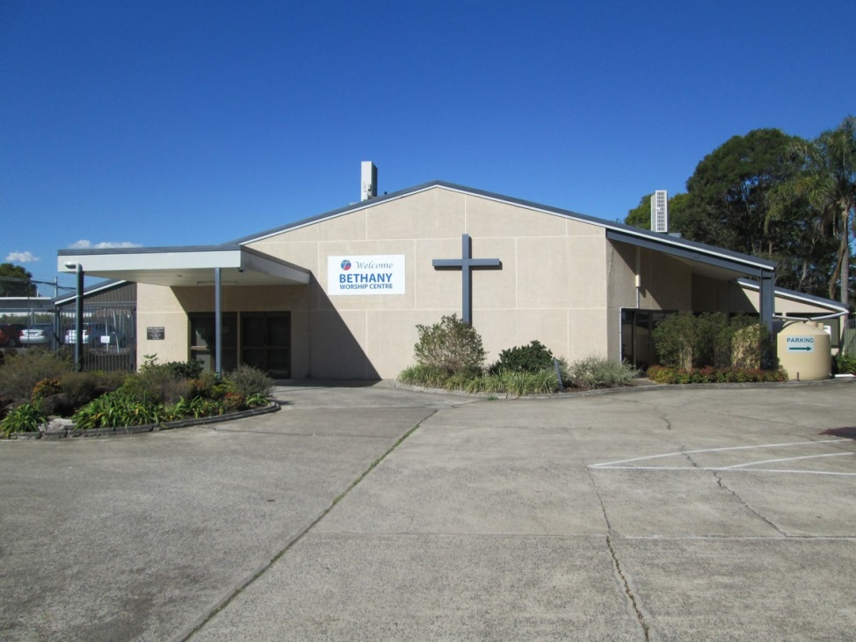
Bethany Lutheran Church
Raceview, QLD
By Levi Podlich

Slide 2
Did your congregation combine with another after the ELCA and UELCA amalgamated?
The congregation of Bethany, was formed as a new church. In 1966 when the amalgamation happened, Bethany hadn't been formed yet. However, at that time, there were two large Lutheran churches in Ipswich. These two churches were located very close together and were named St Johns and St Lukes.

Slide 3
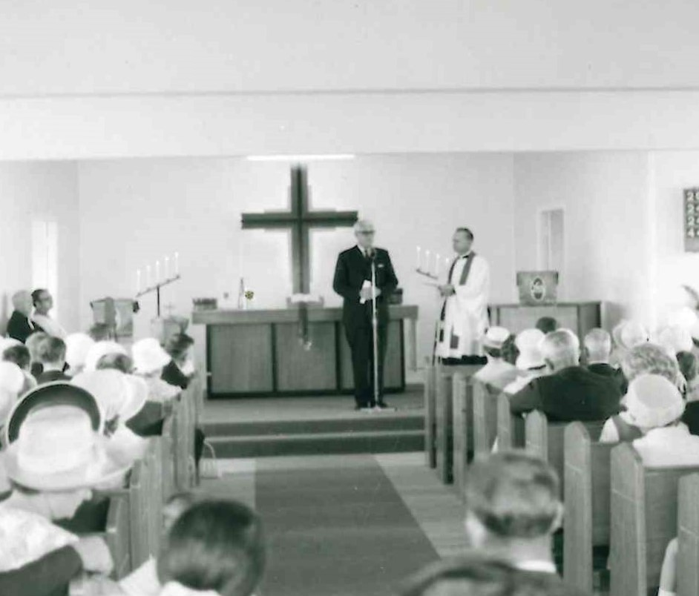
Did your congregation form after 1966?
Members from both St Johns and St Lukes decided to start the new church. In 1967, 10 acres of land was purchased at Raceview. The new church then became a project of St Johns alone. By 1969 a two story brick dwelling was built on the land and on the 8th March 1970 the first church service was held. 72 members transferred from St Johns and St Lukes to start Bethany.
One reason Bethany became the new churches name was due to in the Bible there was a town named Bethany which was located about one and three quarter miles from Jerusalem. In the same way, Bethany was located approximately the same distance from St Johns and St Lukes.

Slide 4
The current church at Bethany is much larger and more modern. This photo was taken whilst it was still under construction
The original church in 1970

Slide 5
Bethany Church Congregation
The church was dedicated in 1970 with a congregation of over 400 people. 72 baptised members transferred from the other two churches but officially, in total, we had 120 baptised members and 65 communicant members.
In 2015, Bethany had 170 baptised members.
Worship: | Average Weekly Attendance | Average Attendance at Holy Communione
2015: | 133 | 68
2014: | 142 | 69
2013: | 158 | 77
2012: | 166 | 86
2011: | 146 | 90
Membership: | Baptised Members | Confirmed Members | Communing Members 18+ | Childrens Groups | Youth Groups | Mens Groups | Womens Groups
2015: | 170 | 129 | 144 | 40 | 0 | 0 | 0
2014: | 173 | 136 | 145 | 44 | 0 | 0 | 0
2013: | 174 | 137 | 148 | 30 | 0 | 0 | 0
2012: | 163 | 126 | 136 | 25 | 0 | 0 | 0
2011: | 173 | 134 | 145 | 24 | 0 | 0 | 0
Pastoral Acts: | Children Baptised | Adults Baptised | Children Confirmed | Adults Confirmed | Marriages | Funerals (adults and children combined)
2015: | 15 | 0 | 0 | 0 | 0 | 3
2014: | 7 | 0 | 1 | 0 | 0 | 2
2013: | 7 | 0 | 0 | 0 | 2 | 3
2012: | 12 | 0 | 3 | 0 | 4 | 6
2011: | 10 | 0 | 1 | 0 | 0 | 6

Slide 6
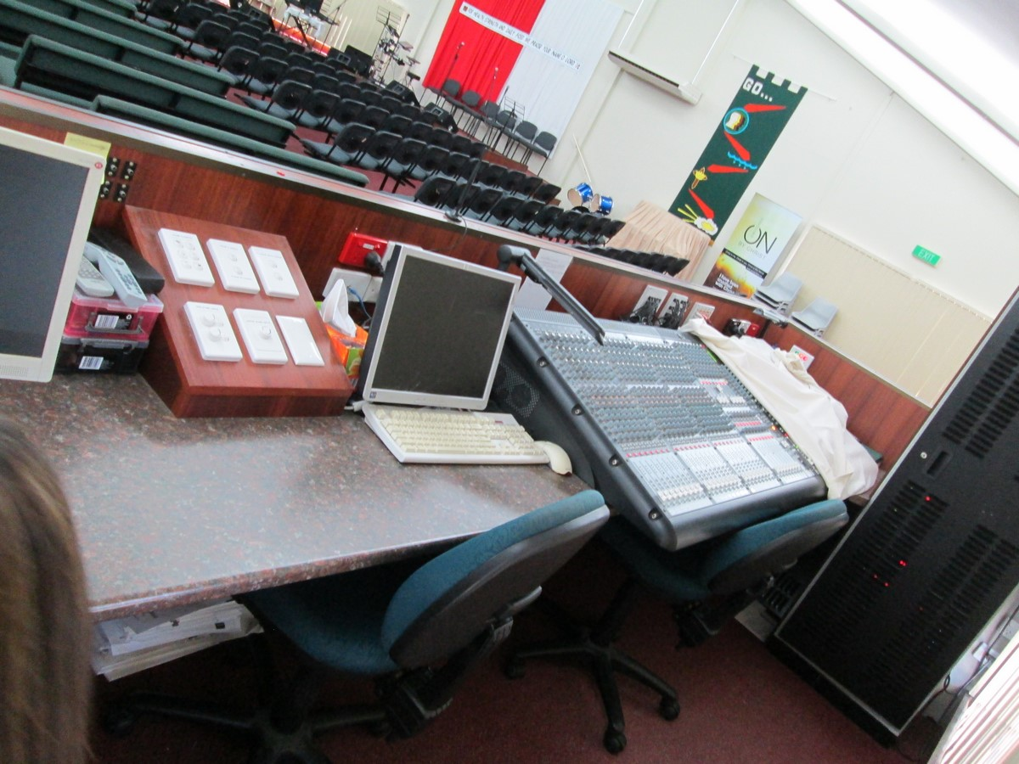
Has your local community changed in other ways? Are you in an urban area where large numbers of migrants have settled in the area and joined the congregation?
We do have some migrant families but not in large amounts. However, our church building is used by an African group for worship on Sunday afternoons.
Raceview, the local community has increased in population. Technology has become much more widely used within the services and church itself. We have a PA system, air-conditioning , projector screens, wireless microphones, computer aided screens for following the services etc.
This is a big step forward from the old purple ink duplicator machines used in the 80s used to distribute crude copies of the service format.

Slide 7
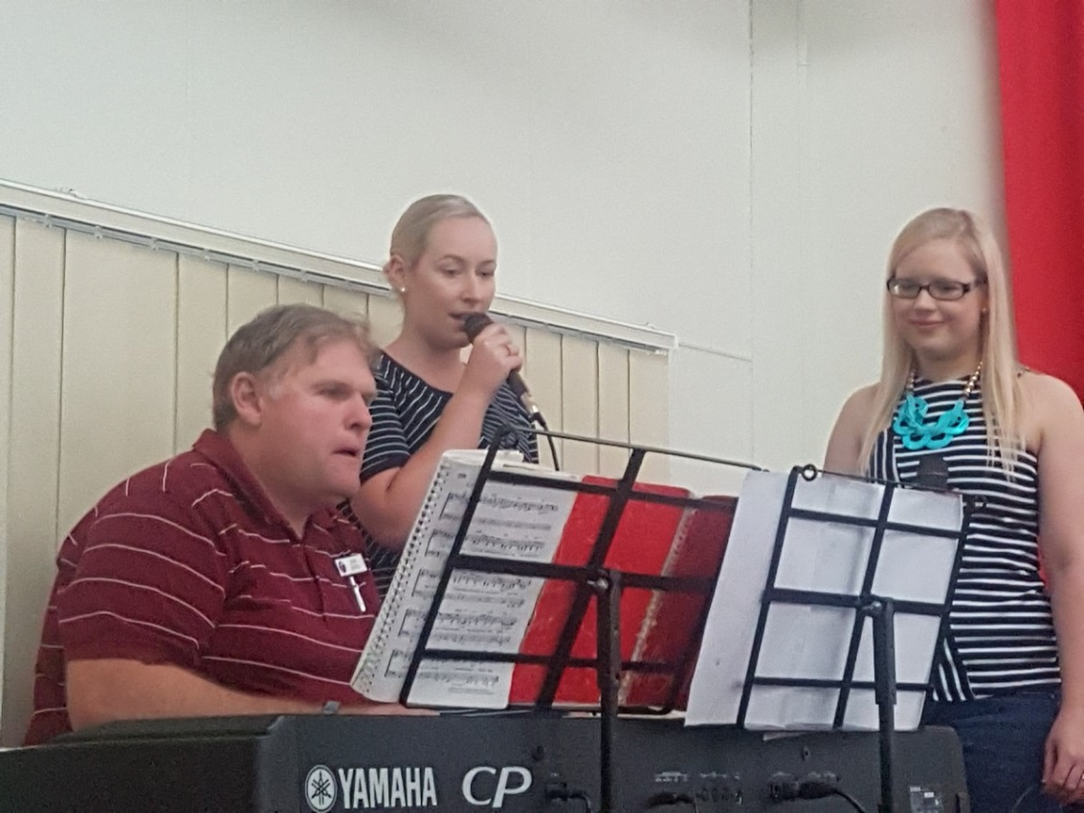
Has your church changed its programs and groups eg youth group, women’s guild etc?
Bethany’s services are now accompanied by a band. This band has drums, piano, organ, guitars, singers etc.
Sunday School still operates today.
We have a youth group called Ignition.
The church also has special mid week services for the elderly.
More things are children’s ministry prayer stations, service greeters and prayer rooms.

Slide 8
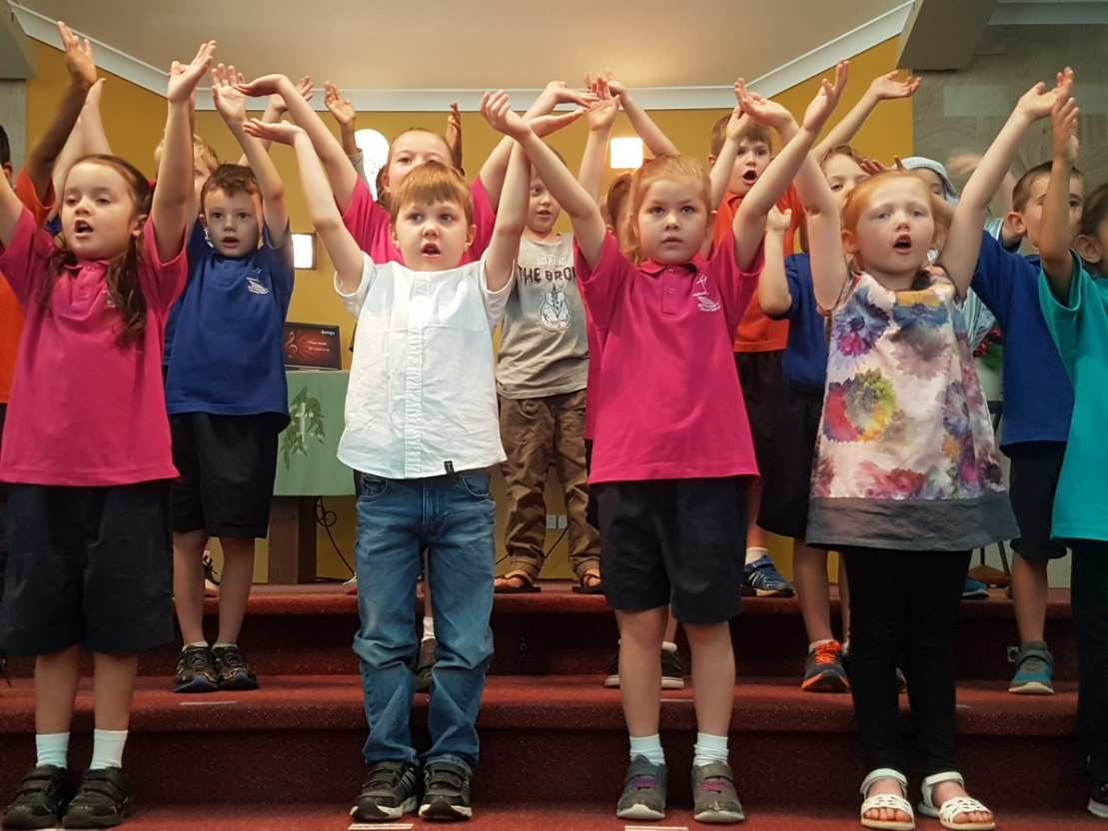
Thing for the future of Bethany Lutheran church…
Bethany Church would like to acquire a new manse for our Pastor. Bethany Church requires more pastoral assistance to combining with Riverview and Ipswich Central congregations to form one Lutheran Church.
They also plan to continue to reach out to Bethany Primary School which is attached to the church.

Slide 9
Added in and taken out
Added in
Taken out
Sound Desk
Army hall

Slide 10
Added in and taken out
added
taken
Band stand
Fences for the pastor and grey carpet

Slide 11
Added taken
New church
Original Bethany Church

Slide 12
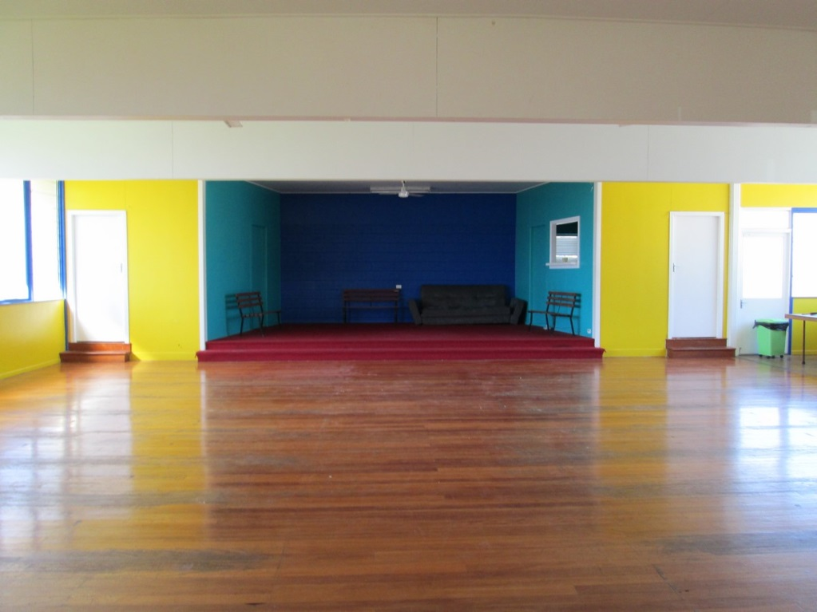
Bethany church comparison
The inside of the original Bethany Lutheran church
Now it’s used as a hall

Slide 13
Bethany church comparison
The church now. you can see the changes made, especially to make way for technology.
The church 23 years ag0

Slide 14
Bethany church comparison
Pastor AUB wore ROBESFOR EACH SERVICE
PASTOR BEN IS MORE CASUAL

Slide 15
Books I used and people I interviewed
These are refrences

Slide 16
Books/Written Information people interviewed
Ipswich Lutheran Parish Website
Lutheran Archives
St John’s : God’s Gracious Story of 150 Years of Lutherans in Ipswich complied and edited by Tim Jarick, 2010
Pastor Aubrey Podlich (retired Ipswich Lutheran Parish Pastor and my Grandad)
Pastor Ben Hentschke (Ipswich Lutheran Parish Pastor)
Mrs Tracy Bock (Bethany Church member and Bethany School Teacher)

Slide 17
Thanks for reading!
Thanks to my library teacher Mrs Crump for helping.

