Slide 1
Going and Growing in the Spirit

Slide 2
Session 4
The Spirit and the
Healing of Community

Slide 3
Session 4
Recap of Session 3
(Steen)

Slide 4
Last week: What’s in a word?
sōzō =
heal, preserve, keep from harm, rescue
All aspects of being adopted as a member of God’s family.
Justification and adoption are two sides of one reality

Slide 5
Last week
This world is not yet heaven…
Living by faith instead of fear
finding the secret formula
vs
trusting the revealed Saviour

Slide 6
Last week … the Holy Spirit produces faith, where and when it pleases God, in those who hear the Gospel. [Article 5 of the Augsburg Confession]
The story of the good news about Jesus is told
The faith question: What do you believe?
Faith is affirmed and we pray to give thanks
Further exploration of the Word of God
Baptism or public affirmation of faith

Slide 7
Last week: Baptised unbelievers?
through deliberate rejection or by neglect
However, if the baptised act against their conscience, permit sin to reign in them, and thus grieve the Holy Spirit in themselves and lose him, then, although they may not be rebaptised, they must be converted again. (Formula of Concord, Article II, 69)

Slide 8
Ephesians 2:13-22
Dwelling in the Word (Steen)

Slide 9
Range finding exercise
Many questions and issues were listed – examples:
Teach people how to work with the Spirit and to be filled again and again. Why do we need to be?
The power of the Spirit in the church today.
Gifts of the Spirit including miracles, healings, prophecy, speaking in tongues, intercession ….
How to tell the difference between Spirit’s guidance and my own thoughts and feelings?
Does the Spirit have an odour or specific feeling?

Slide 10
The Spirit produces fruit and gives gifts
The fruit of the Spirit is is love, joy, peace, patience, kindness, generosity, faithfulness, gentleness, and self-control. [Gal 5:22-23]
There are various lists of gifts which are not intended to be exhaustive. Such gifts as wisdom, knowledge, faith, healing, miracles, prophecy, discernment, tongues and interpretation, assistance, leadership, teaching, pastoral care, intercession, oversight and much more. [1 Cor 12 etc]

Slide 11
No Dualism or Deism here either!

Slide 12
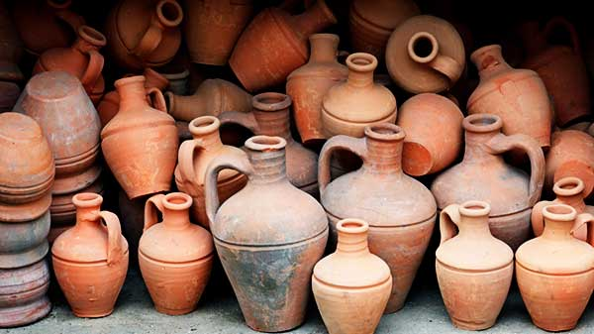

Slide 14
It must be firmly maintained that God gives no-one his Spirit or grace apart from the external Word which goes before. We say this to protect ourselves from … those who boast that they have the Spirit apart from and before contact with the Word. … Everything that boasts of being from the Spirit apart from such a Word and sacrament is of the devil. [Smalcald Articles III 8:3,10]

Slide 15
We let the Word of God permeate our lives
Dwell in the Word / Study the Word / Discuss…
The Word of God is our authority and power
The more the Word of God is alive in us, the easier it is to recognise the Spirit’s voice
Discernment is not perfect in this world
Therefore a little humility goes a long way

Slide 20
X

Slide 22
Discussion Questions
What, if anything, puzzles you about the work of the Spirit today?
What other issues do you want to raise?

Slide 23
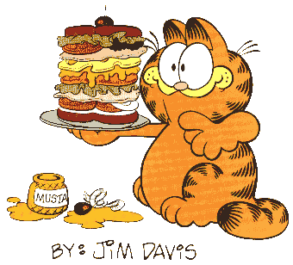
Time for a short break…

Slide 24
Discussion Time
Plenary Session
Any issues or questions that anyone wants to raise?

Slide 25
Next Week
The Spirit and the
Healing of the World
A testimony to the Triune life!
The church on earth is a foretaste of things to come!

