Slide 1
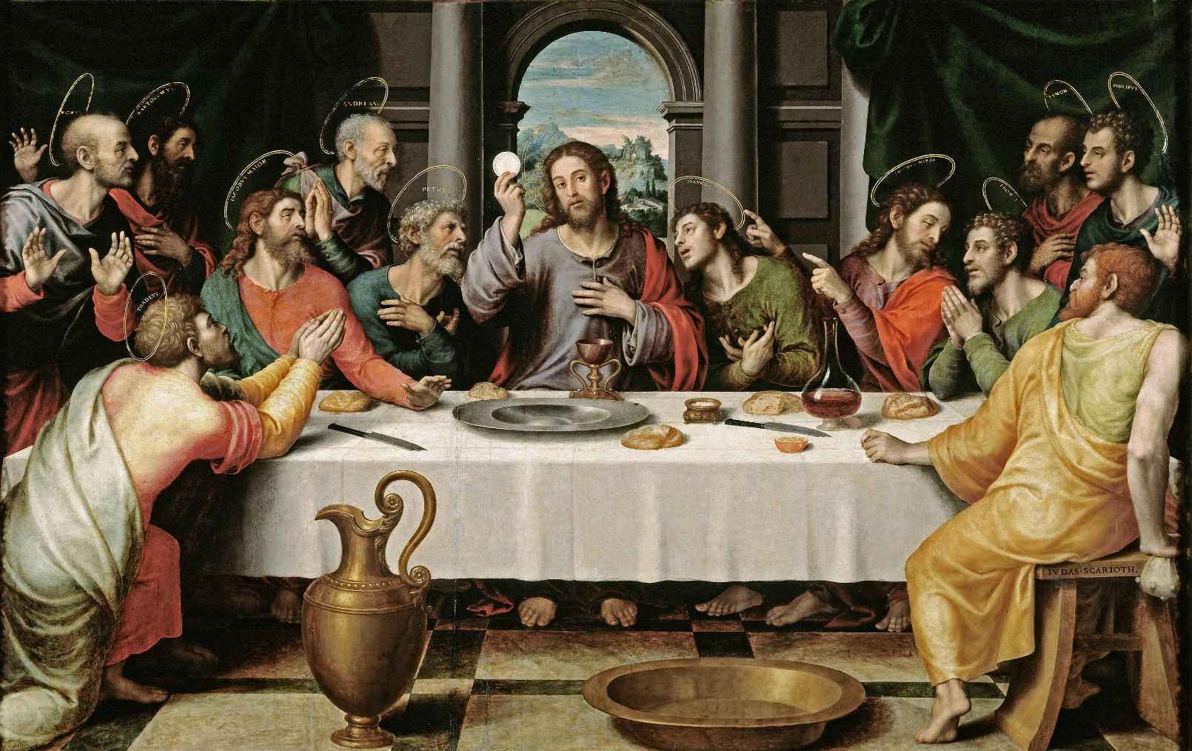
Maundy Thursday

Slide 2
Invocation
In the name of the Father and of the Son † and of the Holy Spirit.
Amen.

Slide 3
Sermon
A sermon may be preached here instead of after the readings and creed.

Slide 4
Confession of sins
Be merciful to me, O God, because of your constant love.
Because of your great mercy wipe away my sins!
Wash away all my evil
and make me clean from my sin!
I recognise my faults;
I am always conscious of my sins.

Slide 5
I have sinned against you — only against you —
and done what you consider evil.
So you are right in judging me;
you are justified in condemning me.
I have been evil from the day I was born;
from the time I was conceived, I have been sinful.
Sincerity and truth are what you require;
fill my mind with your wisdom.

Slide 6
Remove my sin, and I will be clean;
wash me, and I will be whiter than snow.
Let me hear the sounds of joy and gladness;
and though you have crushed me and broken me, I will be happy once again.
Close your eyes to my sins
and wipe out all my evil.

Slide 7
Glory to the Father and the Son and the Holy Spirit,
as it was in the beginning, is now, and will be forever. Amen.

Slide 8
Let us confess our sins to God our Father, and ask him to forgive us through Jesus Christ our Lord.
Lord God, our heavenly Father,
I am a sinner
and I have sinned against you,
not only in my words and actions,
but also in my secret thoughts and desires
which I cannot fully know or understand,
but which you know completely.

Slide 9
I am sorry that I have displeased you,
and repent of the evil I have done.
For the sake of your dear Son,
Jesus Christ our Lord,
have mercy on me,
forgive my sins,
and graciously help me in my weakness.
Amen.

Slide 10
I ask each of you in the presence of God who searches the heart: Do you confess that you have sinned, and do you repent of your sins?
I do.
Do you believe that Jesus Christ has redeemed you from all your sins, and do you desire forgiveness in his name?
I do.
Do you intend with the help of the Holy Spirit to live as in God's presence, and to strive daily to lead a holy life, even as Christ has made you holy?
I do.

Slide 11
Absolution
As you believe, let it be done for you…
that your joy may be full.
Amen.
(The minister may also offer the absolution individually)

Slide 12
Peace
The peace of the Lord be with you.
Amen.
The members of the congregation may exchange the peace with each other.

Slide 13
Hymn/Song

Slide 14
Lord have mercy
Lord, have mercy.
Lord, have mercy.
Christ, have mercy.
Christ, have mercy.
Lord, have mercy.
Lord, have mercy.

Slide 15
Glory to God in the highest
Glory to God in the highest.
And on earth peace,
among those with whom he is pleased.
We praise you, we bless you,
we worship you, we glorify you,
we give thanks to you for your great glory,

Slide 16
O Lord God, heavenly King, God, the Father almighty.
O Lord, the only begotten Son, Jesus Christ,
O Lord God, Lamb of God,
Son of the Father:
You take away the sin of the world;
have mercy on us.

Slide 17
You take away the sin of the world;
receive our prayer.
You are seated at the right hand
of God the Father;
have mercy on us.
For you alone are holy,
you alone are Lord,

Slide 18
you alone, O Christ,
with the Holy Spirit,
are most high in the glory
of God the Father. Amen.

Slide 19
Greeting
The Lord be with you.
And also with you.

Slide 20
Prayer of Maundy Thursday
Let us pray.
Lord Jesus Christ, since you have left us a memorial of your suffering and death in your holy sacrament: Nourish us with your body and blood, so that our lives may show the fruits of your redemption; for you live and reign with the Father and the Holy Spirit, one God, now and forever.
Amen.

Slide 21
First Reading
The first reading for Maundy Thursday is written in chapter —–—— of
—–—— , beginning at verse —–——.
After the reading:
This is the word of the Lord.
Thanks be to God.

Slide 22
Second Reading
The second reading is written in chapter —–—— of —–——, beginning
at verse —–——.
After the reading:
This is the word of the Lord.
Thanks be to God.

Slide 23
Gospel
The holy gospel is written in chapter —– of the Gospel according to St .–, beginning at verse —–.
Glory to you, O Lord.
After the gospel:
This is the gospel of the Lord.
Praise to you, O Christ.

Slide 24
Nicene Creed
We believe in one God,
the Father, the Almighty,
maker of heaven and earth,
of all that is, seen and unseen.

Slide 25
We believe in one Lord, Jesus Christ,
the only Son of God,
eternally begotten of the Father,
God from God, Light from Light,
true God from true God,
begotten, not made,
of one Being with the Father;
through him all things were made.

Slide 26
For us* and for our salvation
he came down from heaven,
was incarnate of the Holy Spirit and the Virgin Mary
and became truly human.
For our sake he was crucified under Pontius Pilate;
he suffered death and was buried.

Slide 27
On the third day he rose again
in accordance with the Scriptures;
he ascended into heaven
and is seated at the right hand of the Father.
He will come again in glory to judge the living and the dead,
and his kingdom will have no end.

Slide 28
We believe in the Holy Spirit, the Lord, the giver of life,
who proceeds from the Father and the Son,
who with the Father and the Son is worshipped and glorified,
who has spoken through the prophets.

Slide 29
We believe in one holy catholic† and apostolic church.
We acknowledge one baptism for the forgiveness of sins.
We look for the resurrection of the dead,
and the life of the world to come. Amen.
* This means: us human beings
† or: Christian; 'catholic' here means 'universal'

Slide 30
Sermon
If a sermon was not preached earlier, one is preached here.

Slide 31
Hymn/Song

Slide 32
Foot washing
The ceremony of foot-washing may be enacted.

Slide 33
Prayer of the Church

Slide 34
Hymn/Song

Slide 35
Preface
The Lord be with you.
And also with you.
Lift up your hearts.
We lift them up to the Lord.
Let us give thanks to the Lord.
For that is fitting and right.

Slide 37
Holy, holy, holy
Holy, holy, holy, Lord God of hosts;
heaven and earth are full of your glory.
Hosanna in the highest.
Blessed is he who comes
in the name of the Lord.
Hosanna in the highest.

Slide 38
Lord’s Prayer
Our Father in heaven, hallowed be your name, your kingdom come, your will be done, on earth as in heaven.
Give us today our daily bread.
Forgive us our sins as we forgive those who sin against us.
Lead us not into temptation, but deliver us from evil.
For the kingdom, the power, and the glory are yours now and forever. Amen.

Slide 39
Words of Institution

Slide 40
Peace
The peace of the Lord be with you always.
Amen.

Slide 41
Lamb of God
O Christ, Lamb of God, you take away the sin of the world; have mercy on us.
O Christ, Lamb of God, you take away the sin of the world; have mercy on us.
O Christ, Lamb of God, you take away the sin of the world; grant us your peace. Amen.

Slide 42
Distribution

Slide 43
Dismissal

Slide 44
Post-communion Prayer
Let us pray.
We give you thanks, almighty God, that you have refreshed us through this healing gift; and we pray that through it you would graciously strengthen us in faith toward you and in love toward one another; through your Son, Jesus Christ our Lord, who lives and reigns with you and the Holy Spirit, one God, now and forever. Amen.

Slide 45
Blessing
The God of love and peace † be with you.
Amen.

Slide 46
Stripping of the altar
The congregation leaves in silence.

