Slide 1
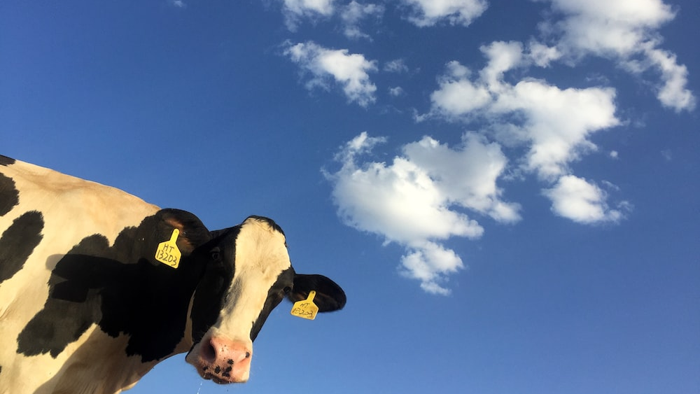
Awkward Grace
The Gospel, Young People and a Cow named Jesus

Slide 2
The struggle to engage is…

Slide 3
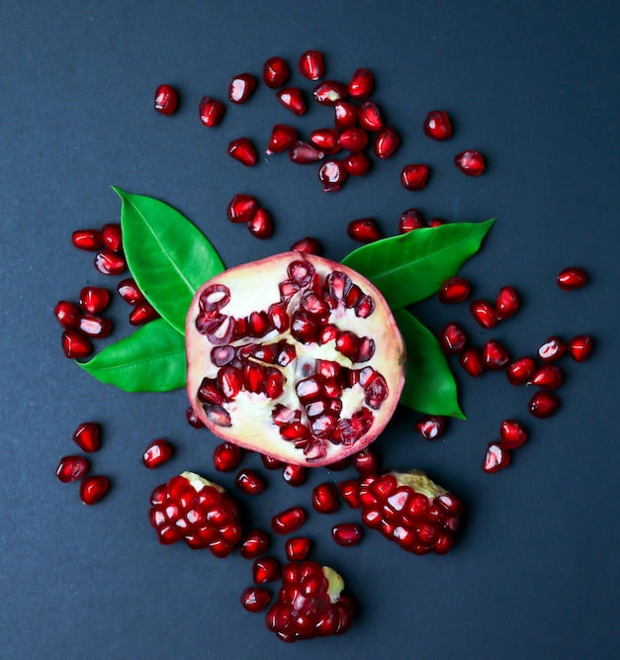
Matthew 13
That same day, Jesus went out of the house and sat by the lake. Such large crowds gathered around him that he got into a boat and sat in it, while all the people stood on the shore. Then he told them many things in parables, saying…
‘A farmer went out to sow his seed…’

Slide 4
Types of Soil
Path
Birds

Slide 5
Types of Soil
Rocky - Shallow
scorched

Slide 6
Types of Soil
thorns
Choked by other plants

Slide 7
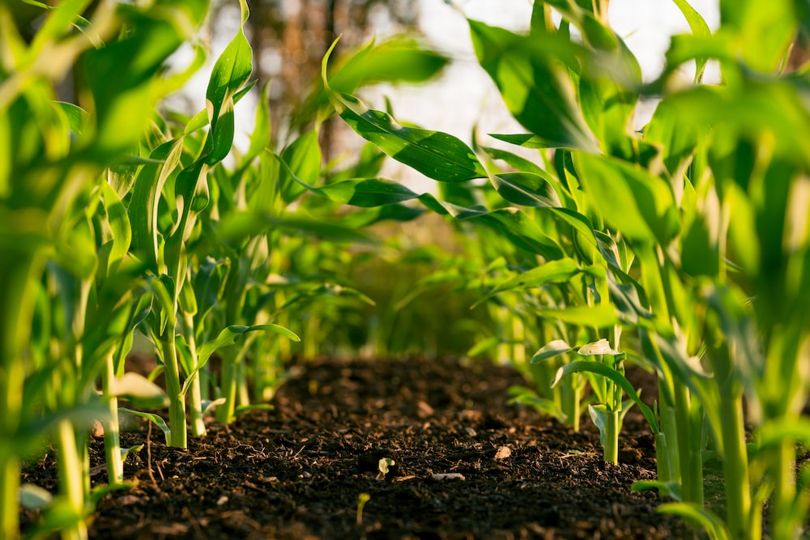
Types of Soil
Good soil

Slide 8
Working with young people and the smattering of holy disdain
What does the soil look like with young people?

Slide 9
Along the path…
What are the birds?
Young people are always being pecked by all sorts of things, not just social media. Constant individualistic self-monitoring, advertising tailored for them to be perpetually unsettled, hen-pecked parents.
The seeds of faith disappear as quickly as they are tossed. Faith is seen as irrelevant and boring.

Slide 10
Stony Ground The world of shallow
How shallow?
The world in which they walk is defined by beauty less than an inch deep and contained in a handheld screen.
Some of the most popular movies in the last few years? A bear that snorts cocaine. A bachelor party defined by its hangover. Endless teenage dramas wallowing in empty sex, wasted youth, and non-stop angst.
Faith is seen as boring and irrelevant, (perhaps even anathema) to developing their ‘brand.’

Slide 11
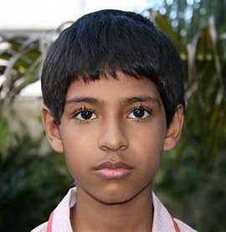
Thorny Ground The choking world of undeniably perplexing relationships
Teens spent an average of 7.5 hours online per day. (Pew)
About 1 in 5 teens use YouTube constantly (Pew)
About 1 in 4 are on the internet constantly (Pew)
54% of teens believe they are online just the right amount (Pew)
90% of Australian kids have been bullied at least once. (Australiareviews)
Kids believe they have no time for faith and it won’t help anyway

Slide 12
What does the face of a young person of fertile soil look like?

Slide 13
Exactly the same.

Slide 14
How do we sow seeds?
Walk the path with them. Explore the motorway of individualism to the goat track of corporate living. Don’t judge. Ask questions. ‘What is your favourite selfie? Tell me about that story?’ Eventually, when trust is built, that indeed they are not being judged or constantly being brought to the ‘good old days,’ they might enquire about a seed that you carry.
Walk with them from the shallows to the depths. Don’t chuck them in the deep end. Don’t judge. Ask questions. ‘Show me how TikTok works? What do you think someone my age might be interested in on TikTok?’ Eventually, when trust is built, that indeed they are not being judged, they might take a step down the slope into waters where they must tread and learn to swim without fear.
Walk with them offline. This is the hardest for us and the easiest for them to feel judged. Share some food with them. Ask questions. Pay attention to their questions and answers. Give them space to retreat online for a few moments. Model good tech habits.

Slide 15
Just because you see this, doesn’t mean that your words haven’t done this…

Slide 16
I am not alone. God is real and loves me. I am precious. I love life.

