Slide 1


Slide 2

Groundswell of Grace
Mark Worthing
Dean of Frontier School of Mission
Pastor, St Peter’s, Port Macquarie

Slide 3
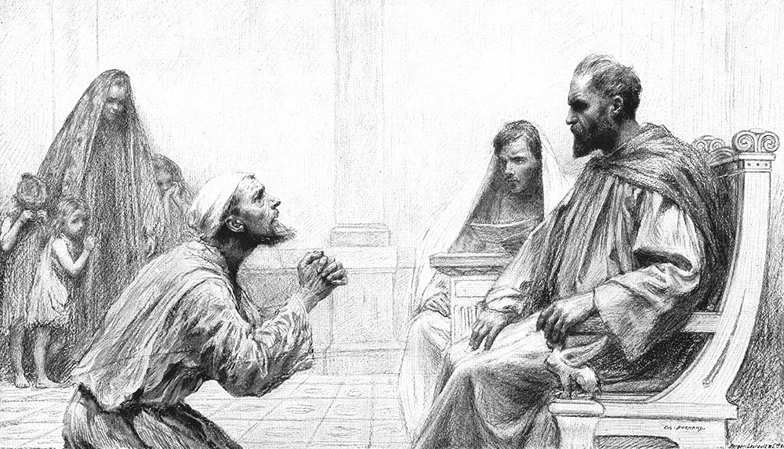
Parable of the Unforgiving Servant

Slide 4
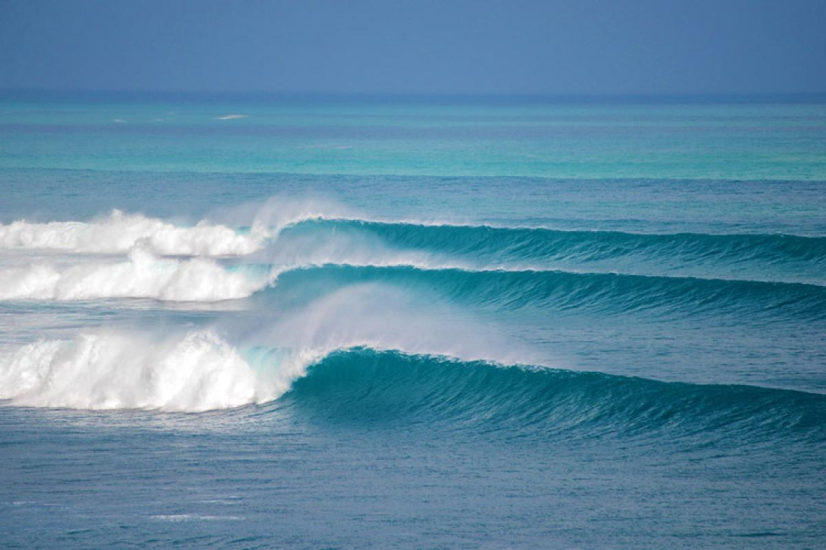

Slide 5

Communities Transformed by Grace

Slide 6

A Community being transformed by Grace is a Thankful Community

Slide 7
A Community being transformed by Grace is a Welcoming Community

Slide 8
A Community being transformed by Grace is a Community not ruled by law

Slide 9
A Community being transformed by Grace is a Community at Peace with God’s Plan for its future

Slide 10
A Community being transformed by Grace is not
a Program-driven Community

Slide 11
A Community being transformed by Grace is a Loving Community

Slide 12
A Community being transformed by Grace is a Community that does life together

Slide 13
A Community being transformed by Grace is a Community continually being surprised by Grace

Slide 14
A Community being transformed by Grace is a Forgiving Community

Slide 15
A Community being transformed by Grace is a Community in which Grace is proclaimed

Slide 16
But what if our Community doesn’t look very much like it is being transformed by Grace?

Slide 17


