Slide 1
The Service
Alternative Form (p.58)
Sung Version
Notes:
Opening slide

Slide 2
How to use this Slideshow
This PowerPoint is designed to be a free resource for LCA members who wish to incorporate or encourage the use of the sung liturgy in their service.
As such, feel free to edit this template to match your worship needs.
Notes:
Explanation part 1

Slide 3
Form Options
The basic options found in the LHS ‘The Service - Alternative Form’ on p. 58 are included in this slideshow.
Points in the slideshow where options are available will be preceded by a ‘hidden’ BLUE title card listing said options.
Notes:
Explanation part 2

Slide 4
Hidden Slides
NOTE: The default visible slides in this PowerPoint are the ‘first form’ or ‘A’ form of the Alternative Service.
To change this, right-click on the target slide to open the slide options and then left-click on ‘hide slide’ (second option from the bottom).
When making changes DON’T forget to ‘hide’ or delete the slides you are no longer using!
Notes:
Explanation part 3

Slide 5
PREPARATION
M: In the name of the Father and of the Son † and of the Holy Spirit.
C: Amen.

Slide 6
HYMN (a hymn may be sung)

Slide 7
CONFESSION & ABSOLUTION
M: Dear friends in Christ: Let us confess our sins to God our Father and ask him in the name of our Lord Jesus Christ to forgive us.

Slide 8
ALL: We confess that we are born in bondage to sin and cannot free ourselves. We have sinned against you in thought, word, and deed, by what we have done and by what we have failed to do. We have not loved you with our whole heart, and we have not loved our neighbour as ourselves. …

Slide 9
… We deserve your eternal punishment. For the sake of your Son, Jesus Christ, have mercy on us. Forgive us, renew us, and lead us, so that we may delight in your will and walk in your ways, to the glory of your holy name. Amen.

Slide 10
M: I ask each of you in the presence of God who searches the heart: Do you confess that you have sinned, and do you repent of your sins?
C: I do.
M: Do you believe that Jesus Christ has redeemed you from all your sins, and do you desire forgiveness in his name?
C: I do.

Slide 11
M: Do you intend with the help of the Holy Spirit to live as in God’s presence, and to strive daily to lead a holy life, even as Christ has made you holy?
C: I do.

Slide 12
M: As a called and ordained servant of the Word, I announce the grace of God to all of you. On behalf of my Lord Jesus Christ, and by his command, I forgive the sins of all of you who repent and believe, in the name of the Father and of the † Son and of the Holy Spirit.
C: Amen.

Slide 13
HYMN (a hymn may be sung)

Slide 14
INTROIT OF THE DAY Options: 1) Said 2) Sung (option to replace hymn) 3) Use appointed Psalm instead

Slide 15
C: Glory to the Father and the Son and the Holy Spirit: as it was in the beginning, is now, and will be for ever. Amen.

Slide 16
KYRIE
Options A or B (Sung or Said)
[Default: Option A]

Slide 17
Notes:
KYRIE option A part 1

Slide 18
Notes:
KYRIE option A part 2

Slide 19
Notes:
KYRIE option A part 3

Slide 20
Notes:
KYRIE option A part 4

Slide 21
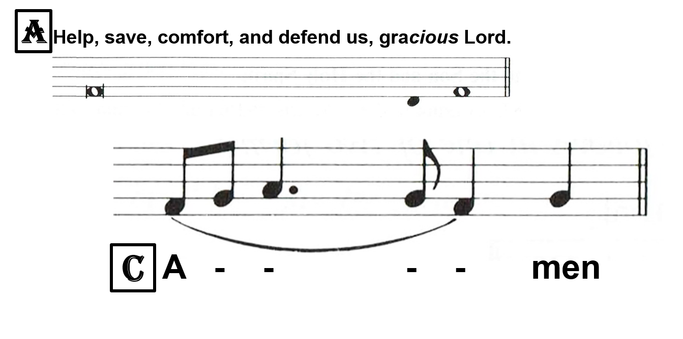
Notes:
KYRIE option A part 5

Slide 22
KYRIE
C: Lord, have mercy. Christ, have mercy. Lord, have mercy.
Notes:
KYRIE option B

Slide 23
HYMN OF PRAISE
Options A or B
[Default: Option A]

Slide 24
Notes:
HYMN OF PRAISE option A part 1

Slide 25
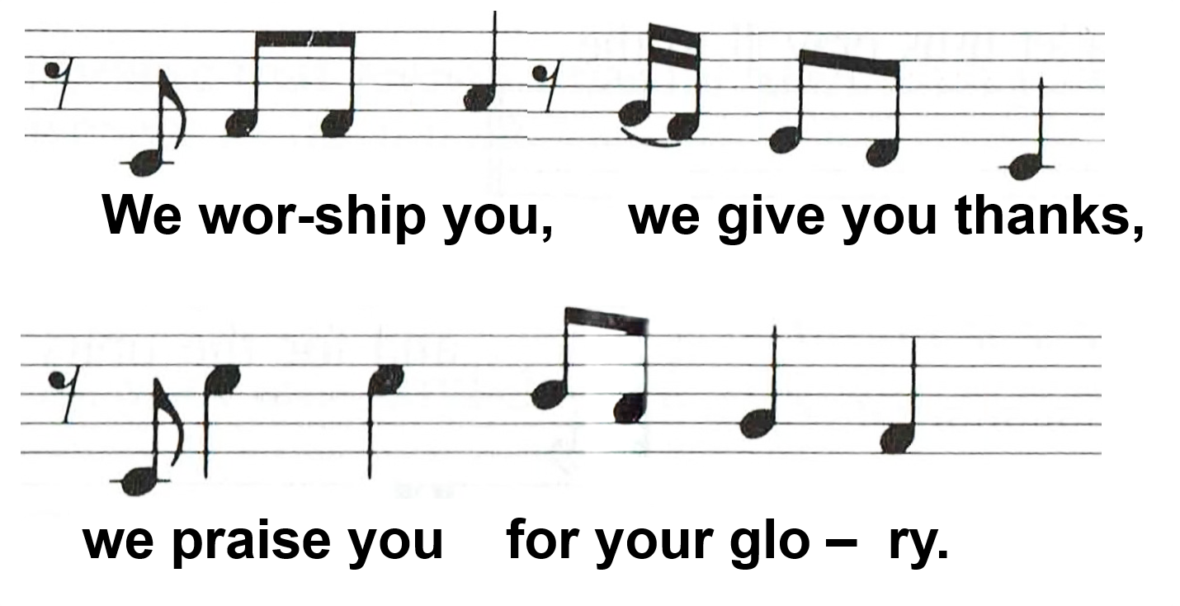
Notes:
HYMN OF PRAISE option A part 2

Slide 26
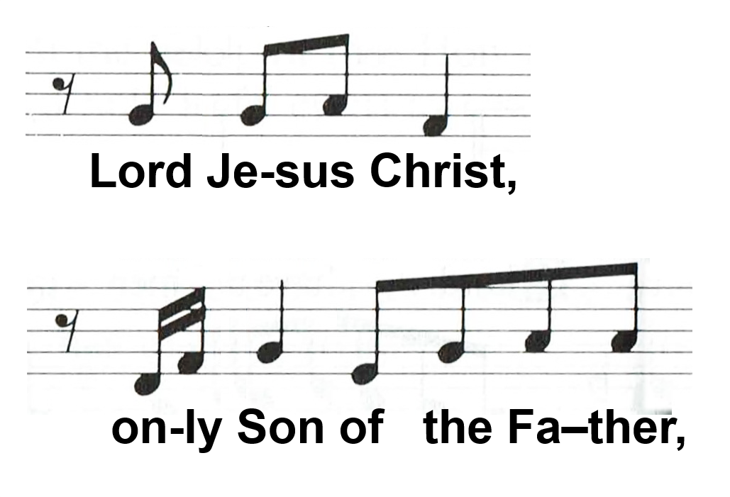
Notes:
HYMN OF PRAISE option A part 3

Slide 27
Notes:
HYMN OF PRAISE option A part 4

Slide 28
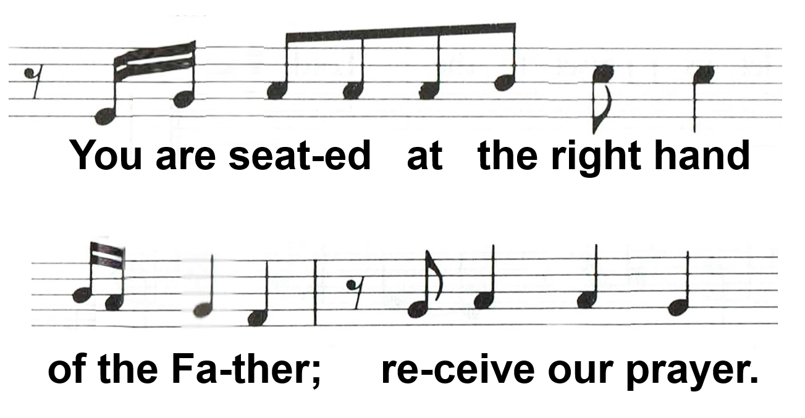
Notes:
HYMN OF PRAISE option A part 5

Slide 29
Notes:
HYMN OF PRAISE option A part 6

Slide 30
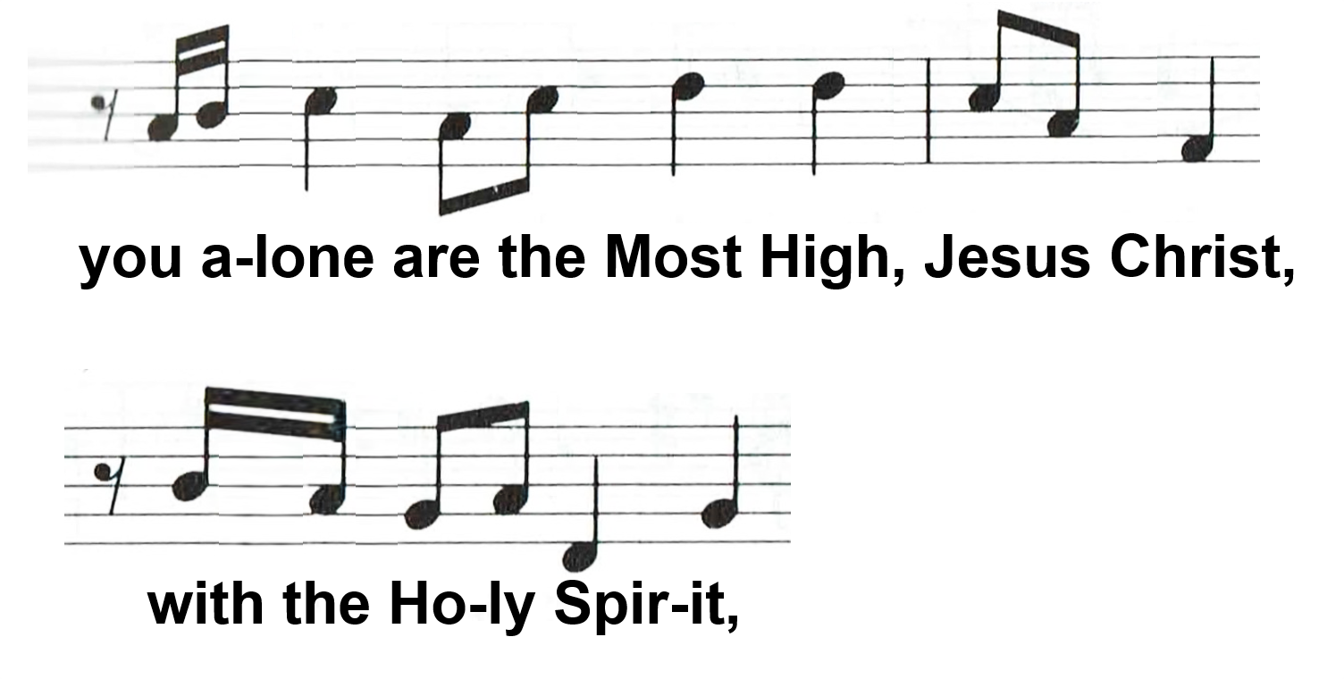
Notes:
HYMN OF PRAISE option A part 7

Slide 31
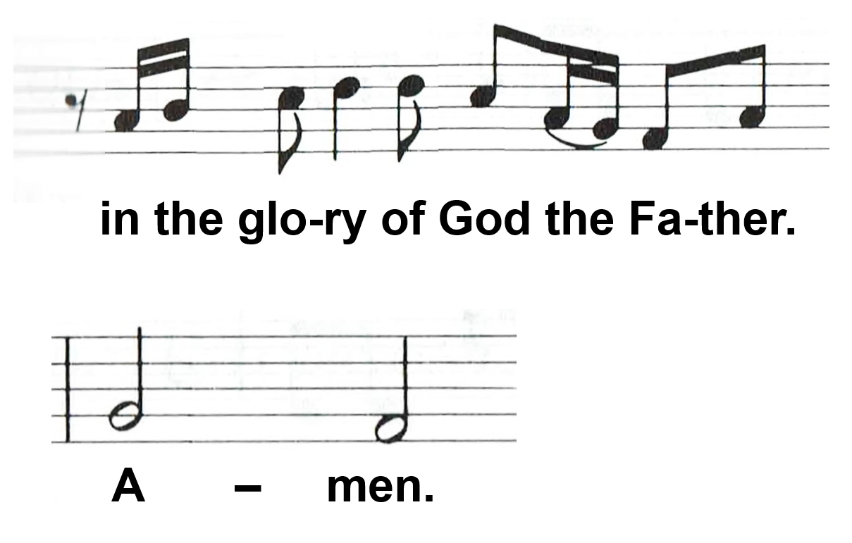
Notes:
HYMN OF PRAISE option A part 8

Slide 32
Notes:
HYMN OF PRAISE option B part 1

Slide 33
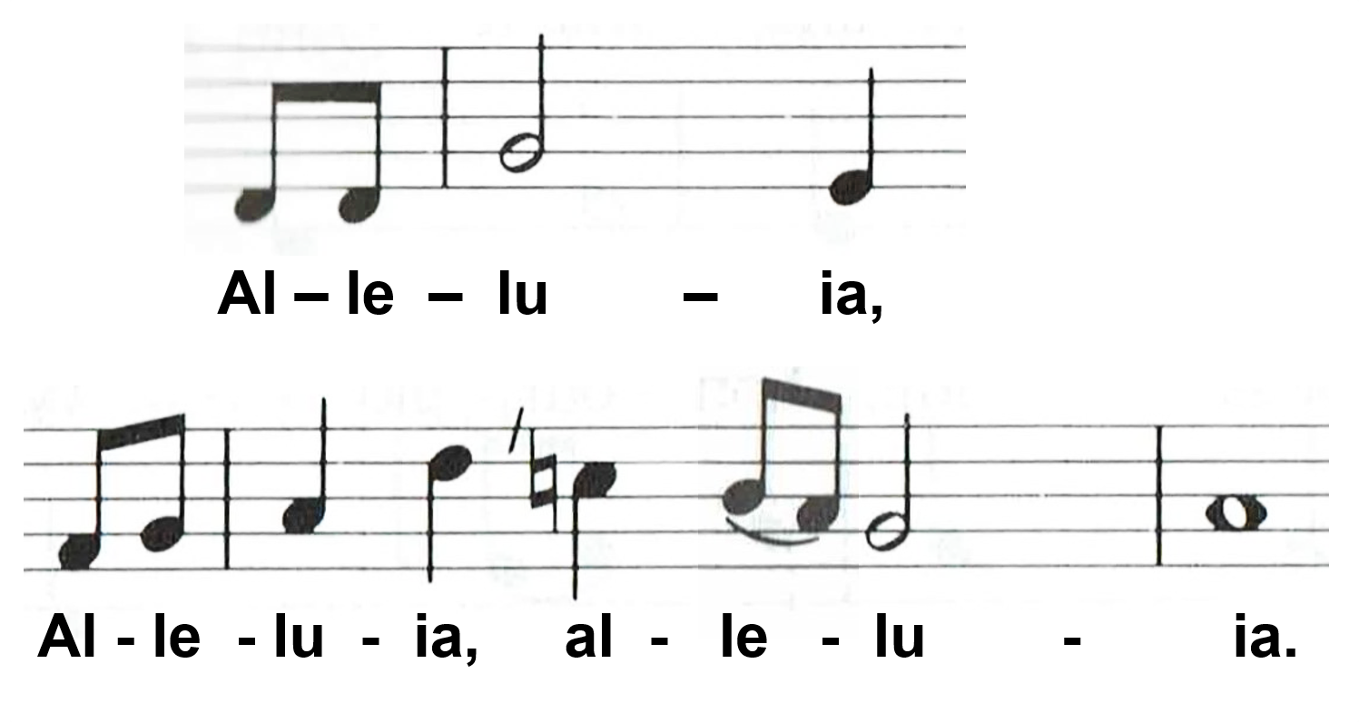
Notes:
HYMN OF PRAISE option B part 2

Slide 34
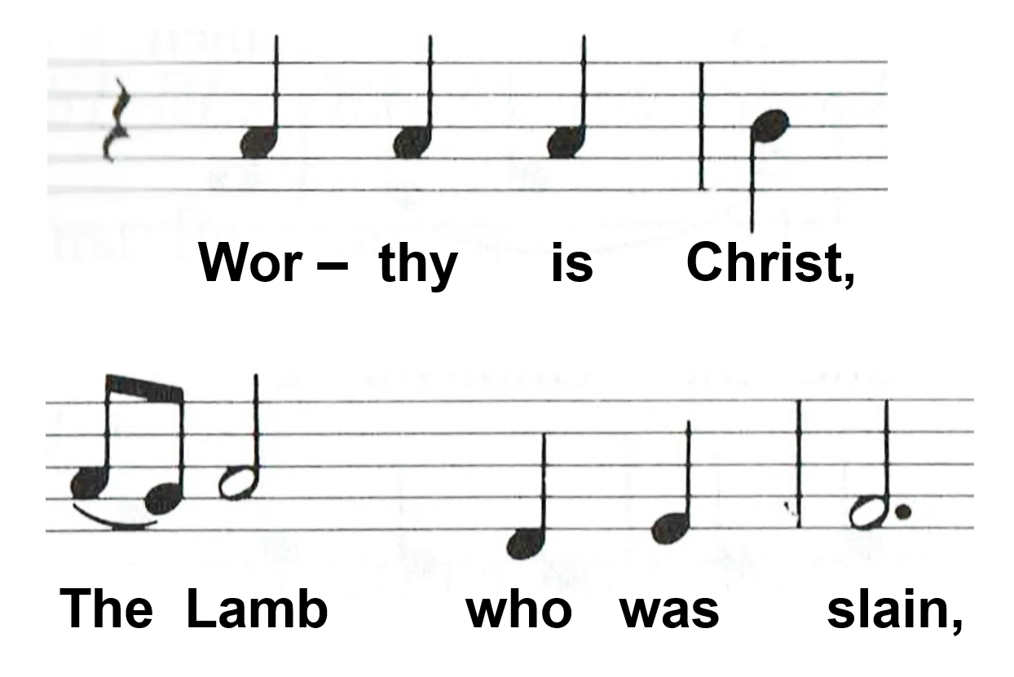
Notes:
HYMN OF PRAISE option B part 3

Slide 35
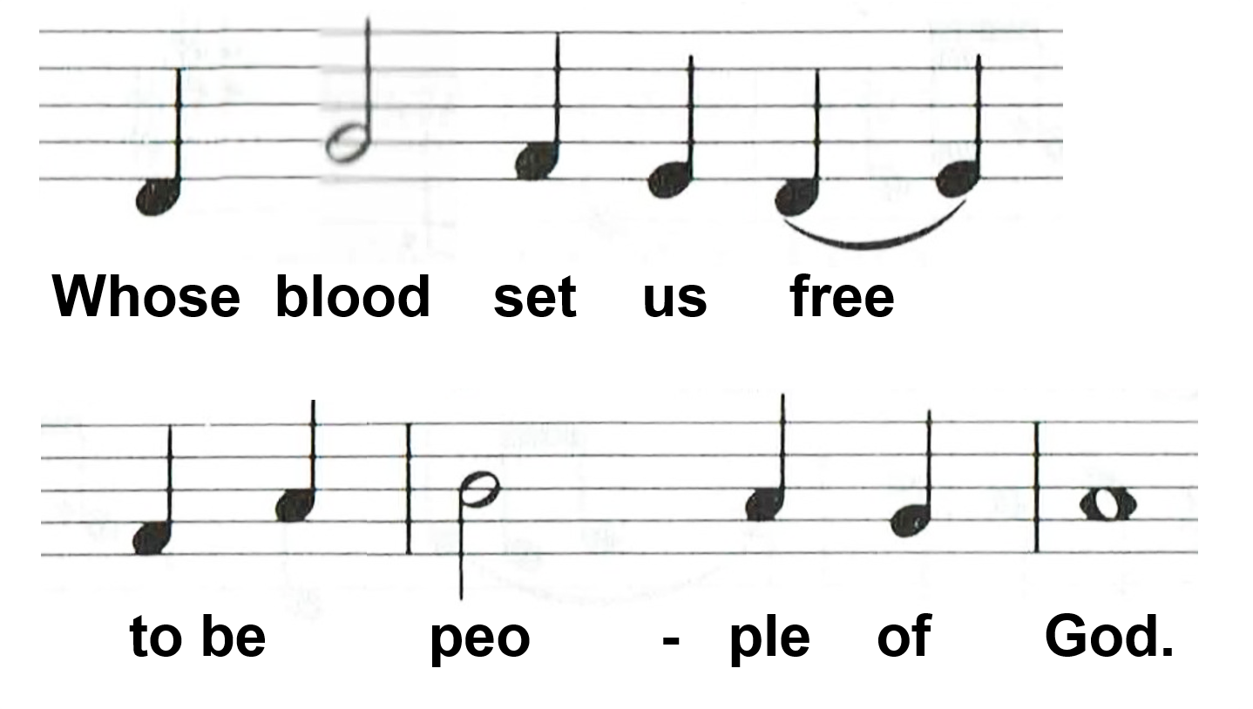
Notes:
HYMN OF PRAISE option B part 4

Slide 36
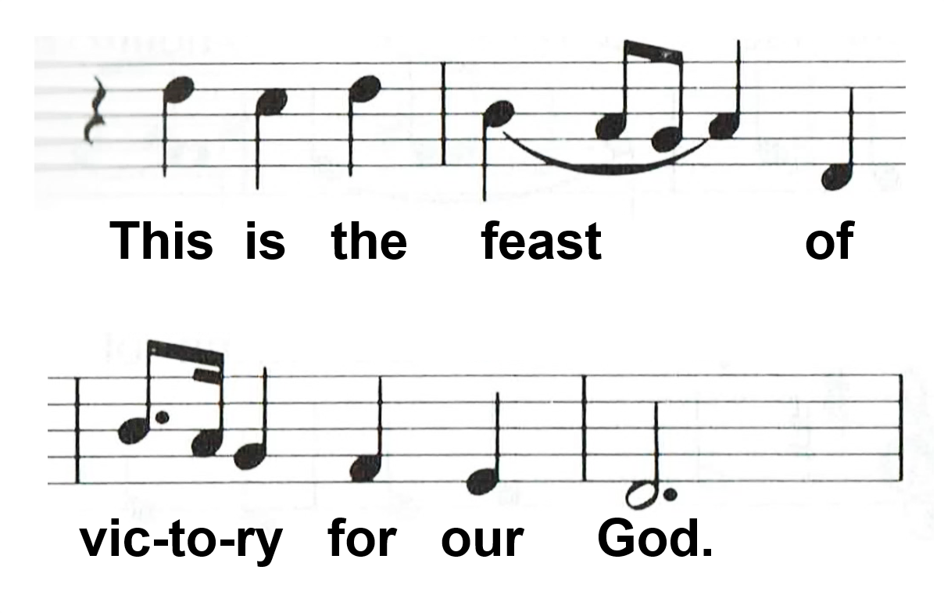
Notes:
HYMN OF PRAISE option B part 5

Slide 37
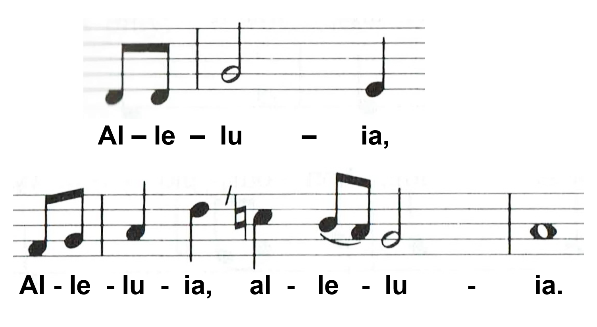
Notes:
HYMN OF PRAISE option B part 6

Slide 38
Notes:
HYMN OF PRAISE option B part 7

Slide 39
Notes:
HYMN OF PRAISE option B part 8

Slide 40
Notes:
HYMN OF PRAISE option B part 9

Slide 41
Notes:
HYMN OF PRAISE option B part 10

Slide 42
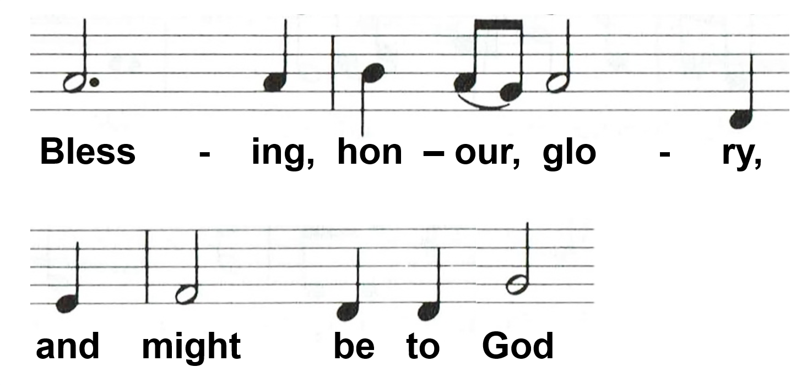
Notes:
HYMN OF PRAISE option B part 11

Slide 43
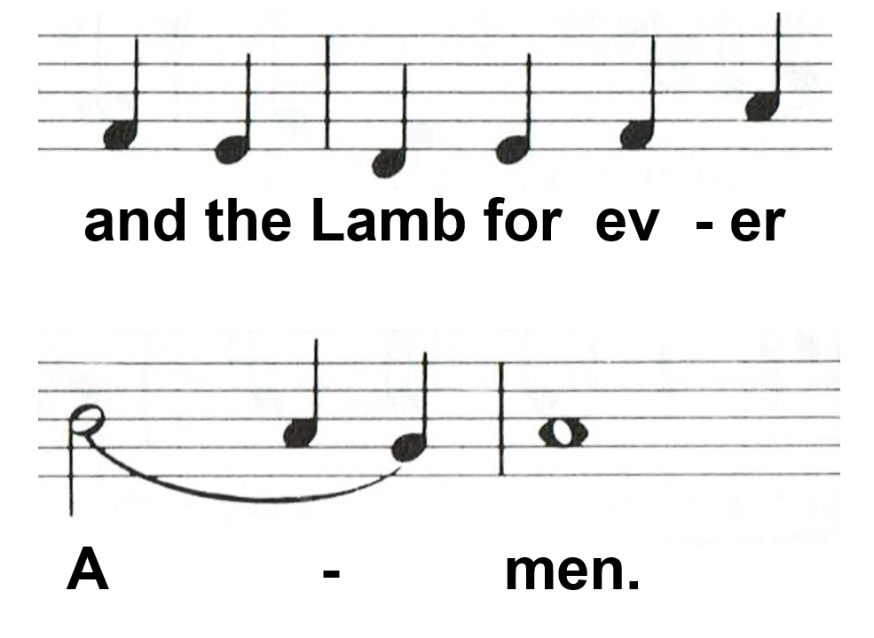
Notes:
HYMN OF PRAISE option B part 12

Slide 44
Notes:
HYMN OF PRAISE option B part 13

Slide 45
Notes:
HYMN OF PRAISE option B part 14

Slide 46
Notes:
HYMN OF PRAISE option B part 15

Slide 47
Notes:
HYMN OF PRAISE option B part 16

Slide 48
Notes:
HYMN OF PRAISE option B part 17

Slide 49
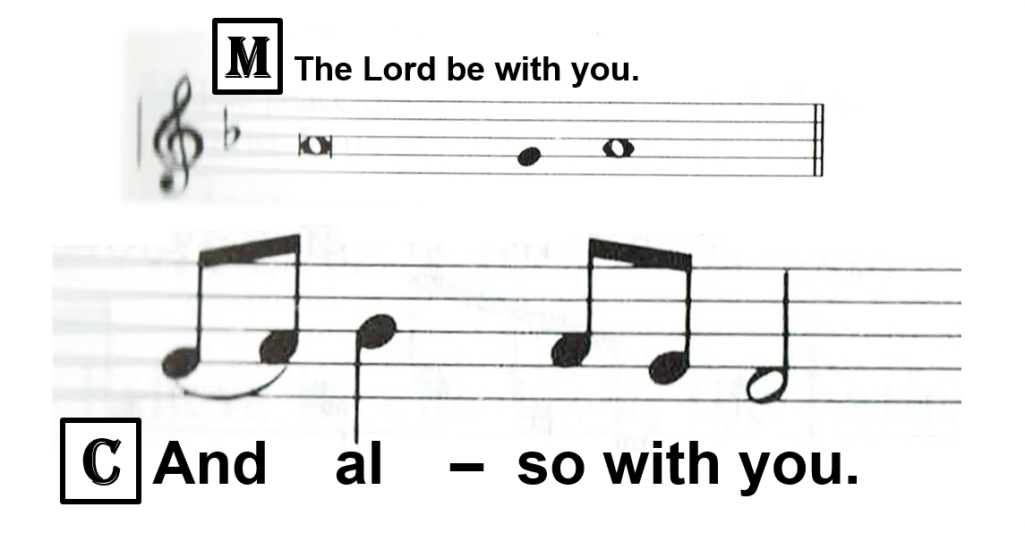
GREETING

Slide 50
COLLECT OF THE DAY
M: Let us pray…
… one God, now and forever.
C: Amen.

Slide 51
FIRST READING
A: The First Reading for … is written in Chapter … of … , beginning at verse …
(After the reading:)
A: This is the Word of the Lord.
C: Thanks be to God.

Slide 52
ANTIPHON OR PSALM (May be sung or said)

Slide 53
SECOND READING
A: The Second Reading for … is written in Chapter … of … , beginning at verse …
(After the reading:)
A: This is the Word of the Lord.
C: Thanks be to God.

Slide 54
READING RESPONSE
Options A or B (General or Lent) OR an appropriate hymn may be sung
[Default: Option A]

Slide 55
Notes:
READING RESPONSE option A

Slide 56
Notes:
READING RESPONSE option B – Lent part 1

Slide 57
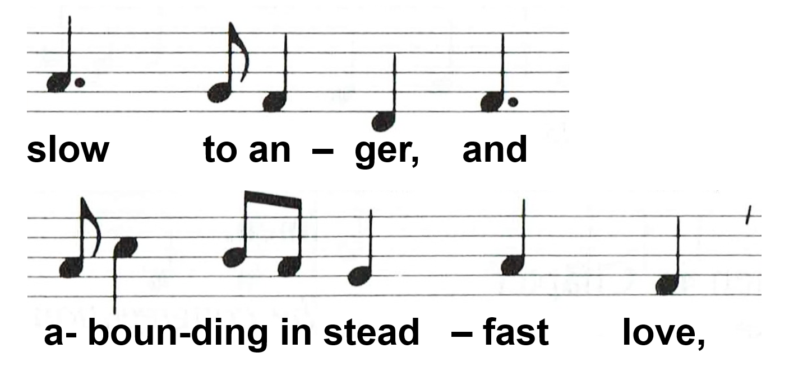
Notes:
READING RESPONSE option B – Lent part 2

Slide 58
GOSPEL
M: The Holy Gospel is written in Chapter ... of the Gospel according to St … , beginning at verse …
(Before the Gospel)

Slide 59
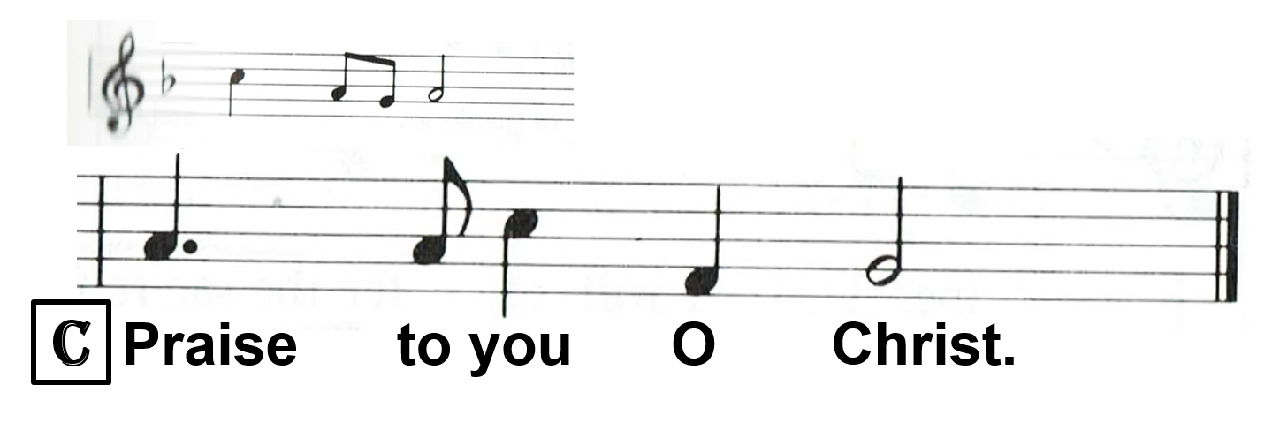
(After the gospel:)
M: This is the gospel of the Lord.

Slide 60
HYMN (a hymn may be sung)

Slide 61
SERMON
(After the Sermon)
M: The peace of God, which is beyond all understanding, keep your hearts and minds in Christ Jesus.
C: Amen.

Slide 62
NICENE CREED
ALL: We believe in one God, the Father, the Almighty, maker of heaven and earth, of all that is, seen and unseen. …

Slide 63
…We believe in one Lord, Jesus Christ, the only Son of God, eternally begotten of the Father, God from God, Light from Light, true God from true God, begotten, not made, of one Being with the Father. Through him all things were made. …

Slide 64
…For us men and for our salvation he came down from heaven; by the power of the Holy Spirit he was incarnate of the virgin Mary, and became man. For our sake he was crucified under Pontius Pilate; he suffered death and was buried. …

Slide 65
…On the third day he rose again in accordance with the Scriptures; he ascended into heaven and is seated at the right hand of the Father. He will come again in glory to judge the living and the dead, and his kingdom will have no end. …

Slide 66
…We believe in the Holy Spirit, the Lord, the giver of life, who proceeds from the Father and the Son. With the Father and the Son he is worshipped and glorified. He has spoken through the prophets. …

Slide 67
…We believe in one holy catholic* and apostolic Church. We acknowledge one baptism for the forgiveness of sins. We look for the resurrection of the dead, and the life of the world to come. Amen.
*or: Christian; ‘catholic’ here means ‘universal’.

Slide 68
HYMN (a hymn is sung if one has not been sung before the sermon)

Slide 69
OFFERING (Can be collected during previous hymn)

Slide 70
OFFERTORY
Options A, B, or C (General, Lent, or alt. Create in me a clean heart…)
[Default: Option A]

Slide 71
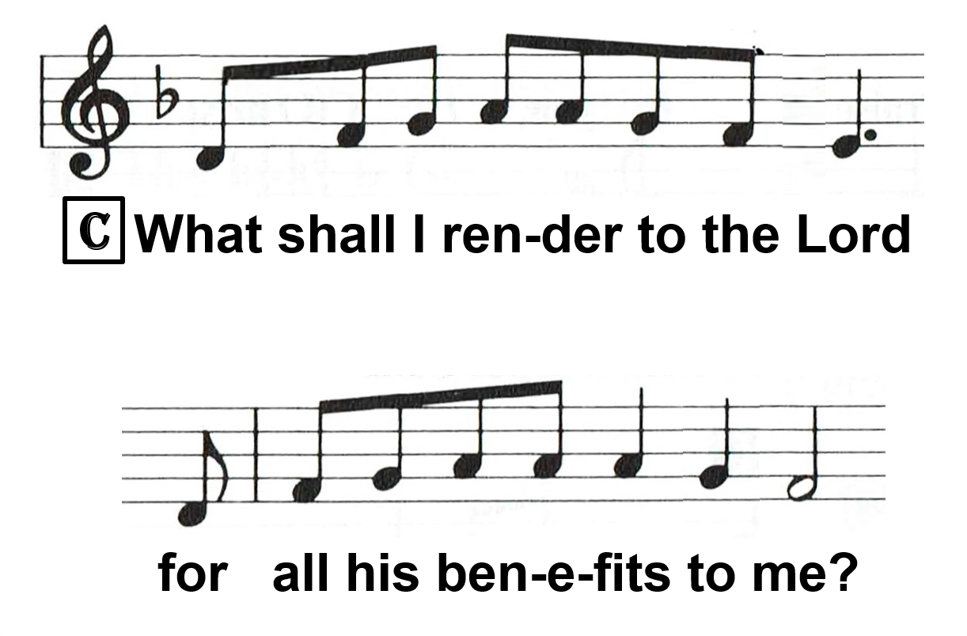
Notes:
OFFERTORY option A part 1

Slide 72
Notes:
OFFERTORY option A part 2

Slide 73
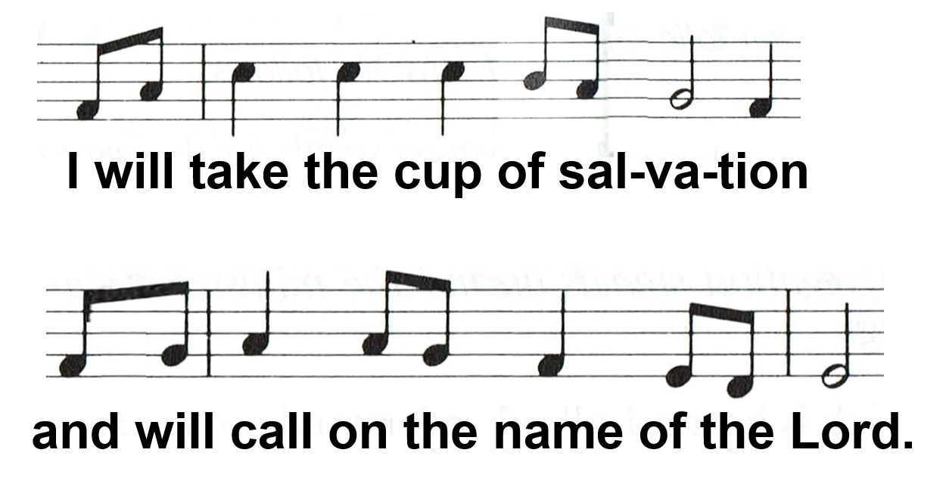
Notes:
OFFERTORY option A part 3

Slide 74
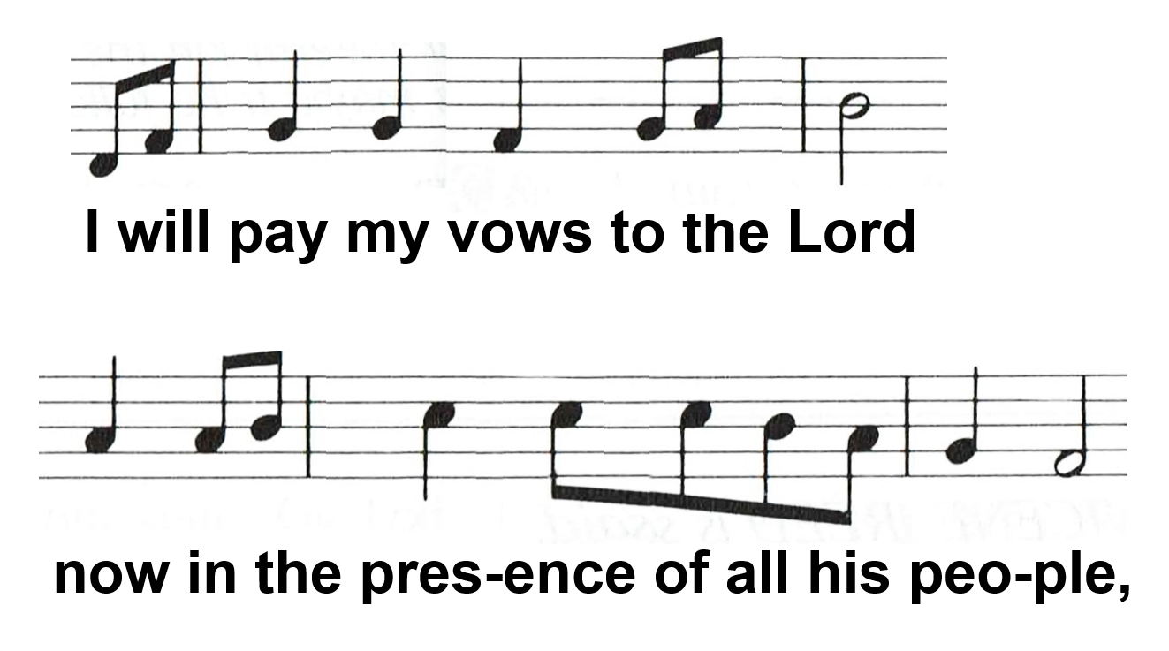
Notes:
OFFERTORY option A part 4

Slide 75
in the courts of the Lord’s house,
in the midst of you, O Je-ru-sa-lem.
Notes:
OFFERTORY option A part 5

Slide 76
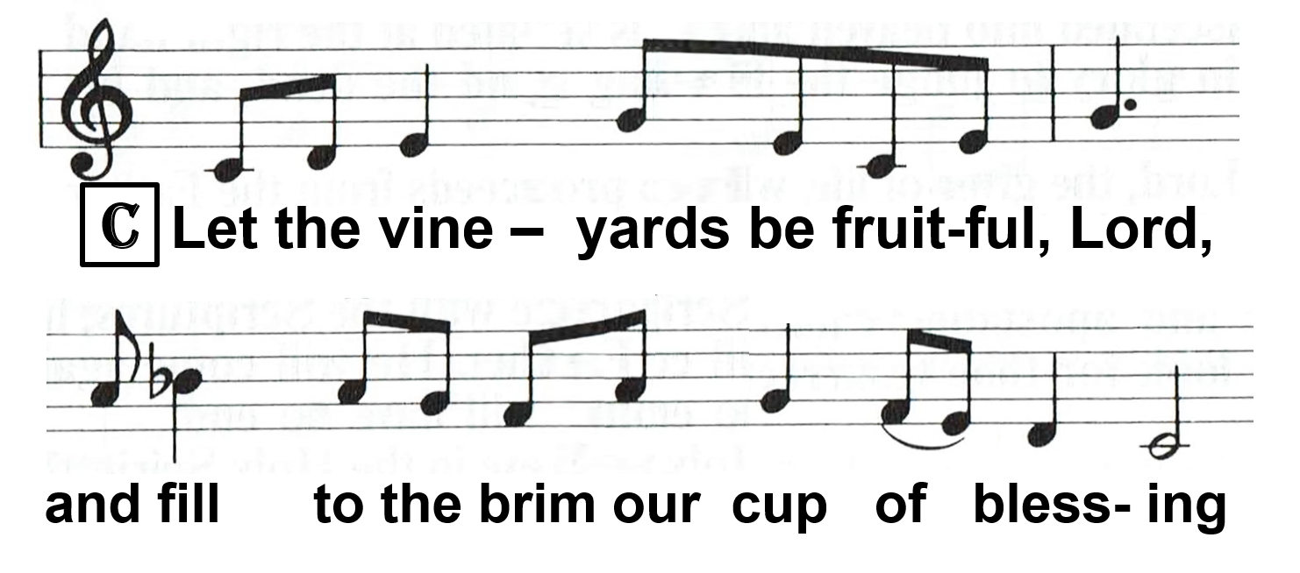
Notes:
OFFERTORY option B - Lent part 1

Slide 77
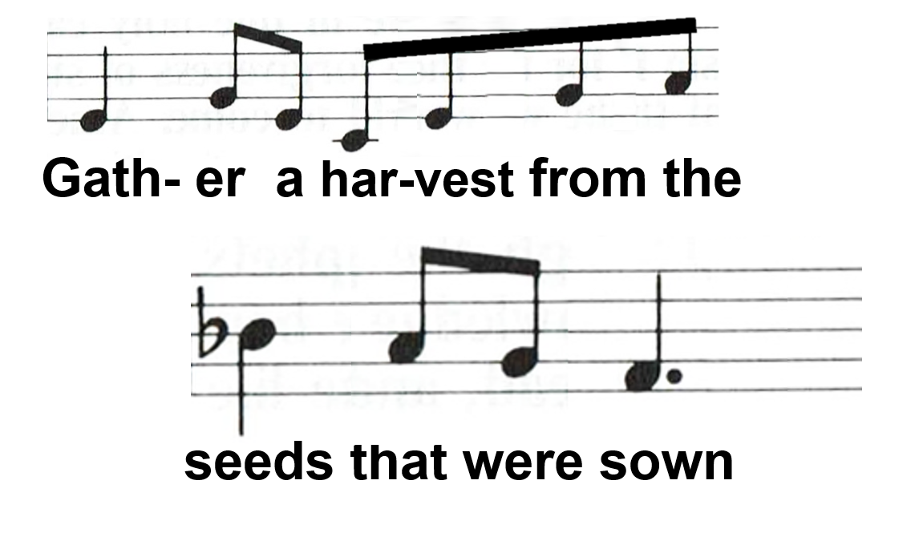
Notes:
OFFERTORY option B - Lent part 2

Slide 78
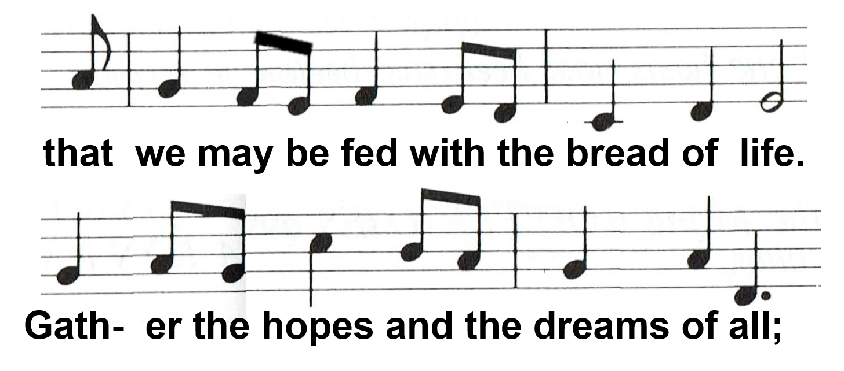
Notes:
OFFERTORY option B - Lent part 3

Slide 79
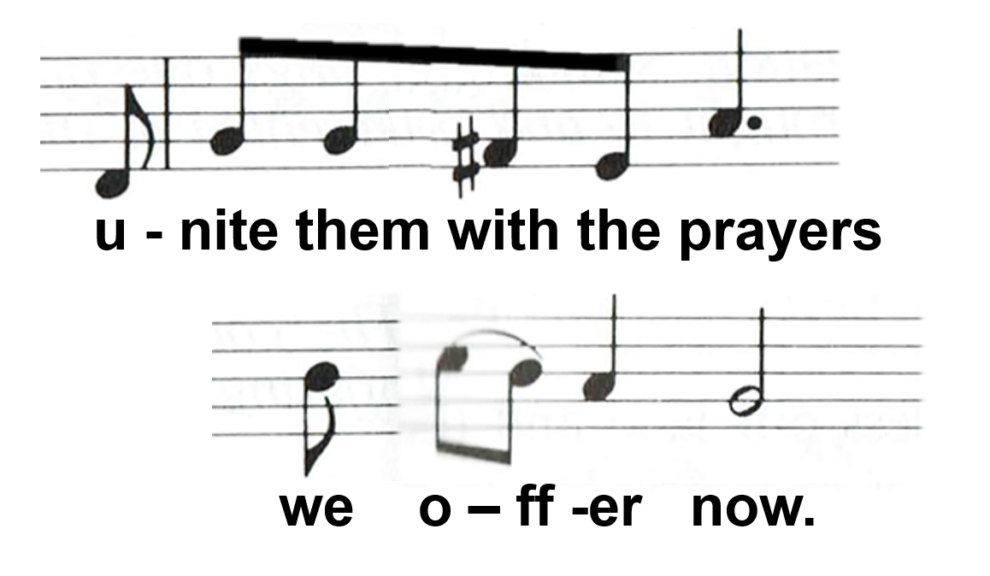
Notes:
OFFERTORY option B - Lent part 4

Slide 80
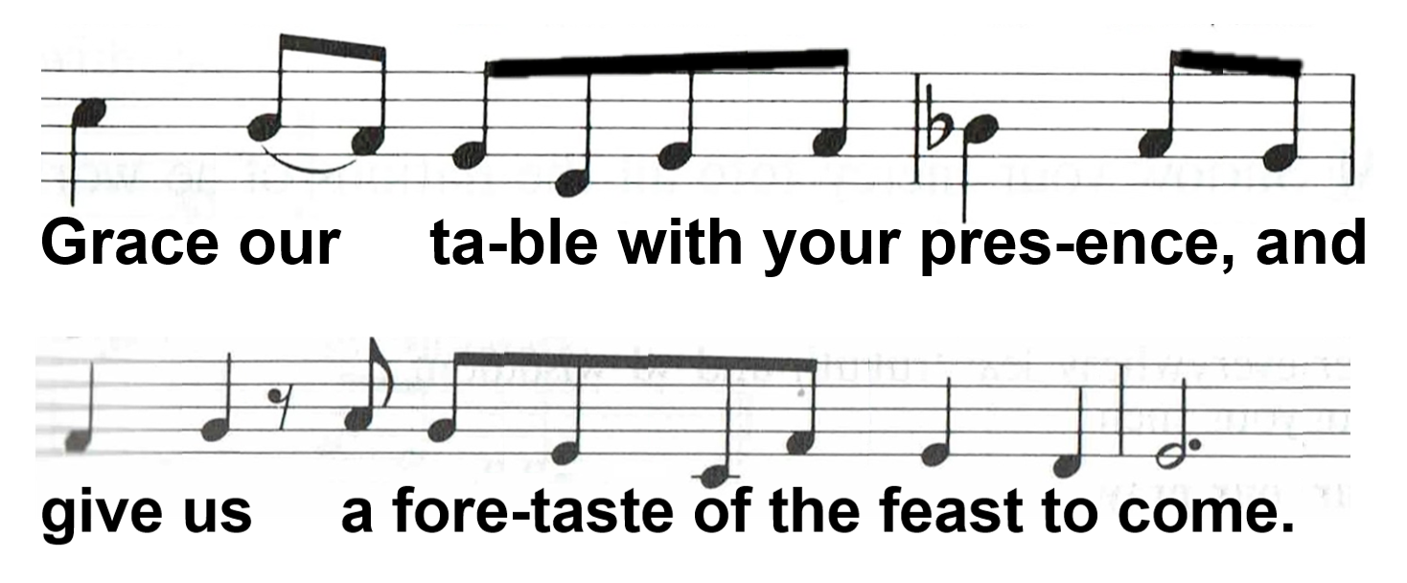
Notes:
OFFERTORY option B - Lent part 5

Slide 81
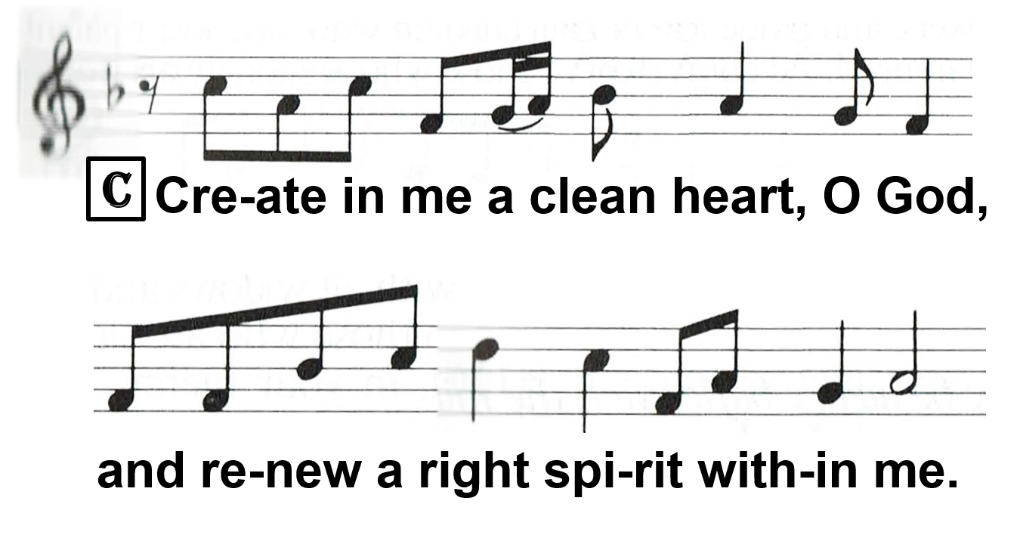
Notes:
OFFERTORY option C part 1

Slide 82
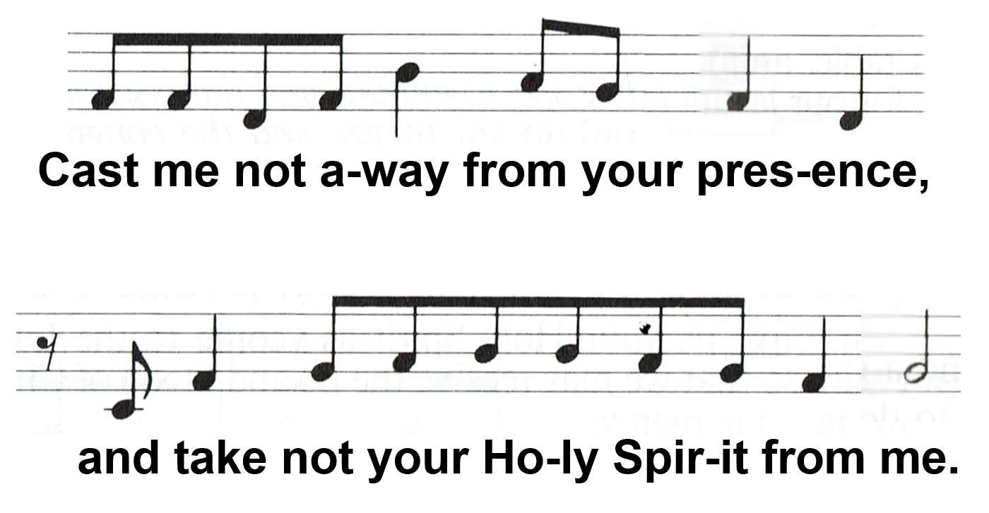
Notes:
OFFERTORY option C part 2

Slide 83
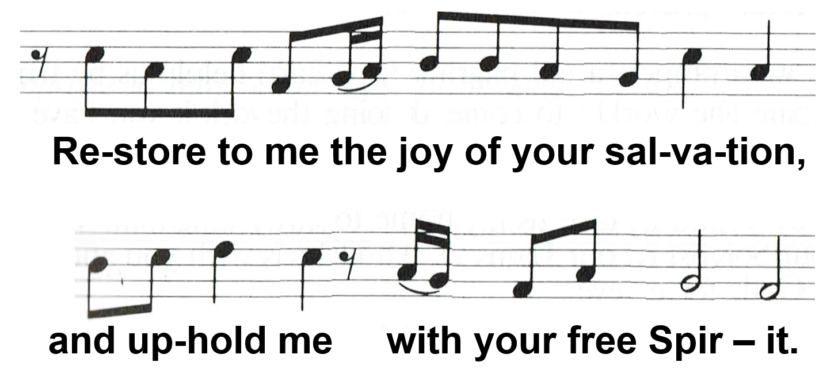
Notes:
OFFERTORY option C part 3

Slide 84
PRAYER OF THE CHURCH
M: Let us pray for the whole people of God in Christ Jesus and for all people according to their needs. …
(Response:)
M: Lord, in your mercy:
C: Hear our prayer.

Slide 85
HYMN (a hymn is sung if one has not been sung before the sermon)

Slide 86
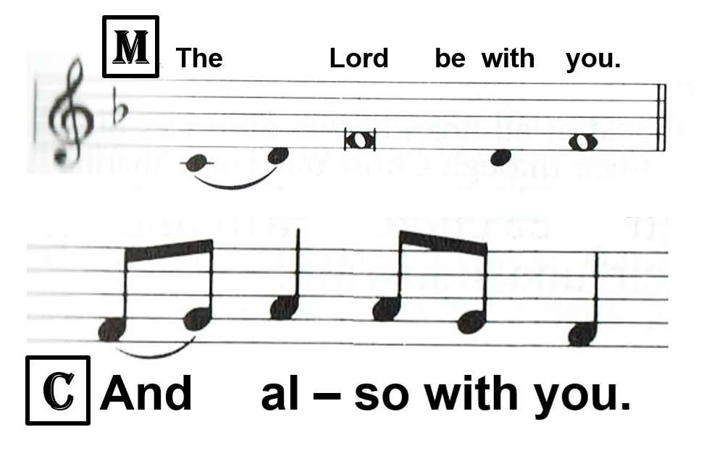
PREFACE

Slide 87
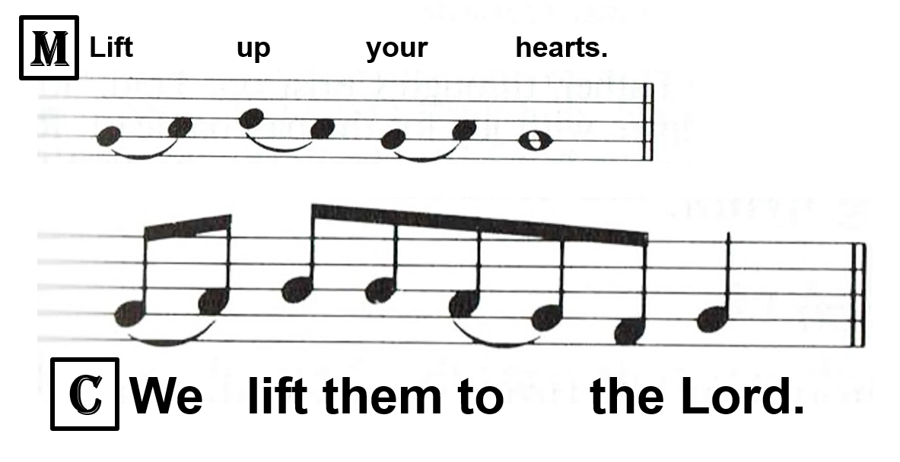

Slide 89
SEASONAL PREFACE (Sung or said)
M: It is indeed right and salutary that we should at all times and in all places offer thanks and praise to you, O Lord, holy Father, …
…And so, with the church on earth and the hosts of heaven, we praise your name and join their unending hymn:

Slide 90
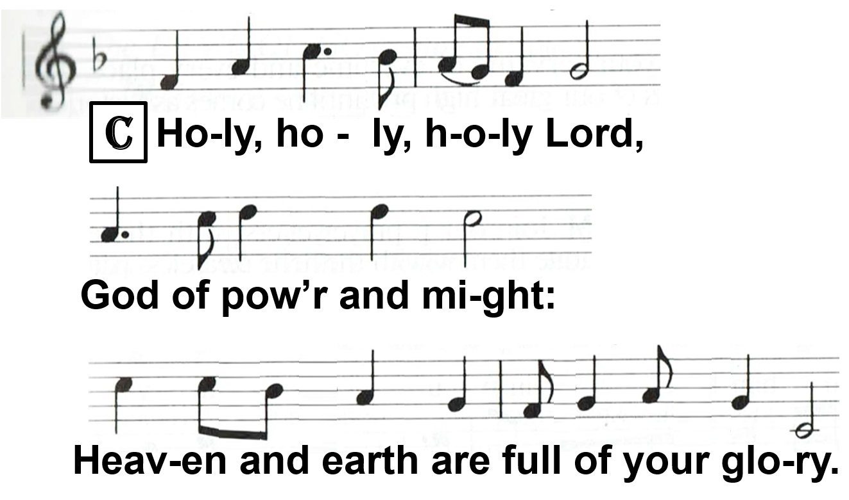
HOLY, HOLY, HOLY

Slide 91
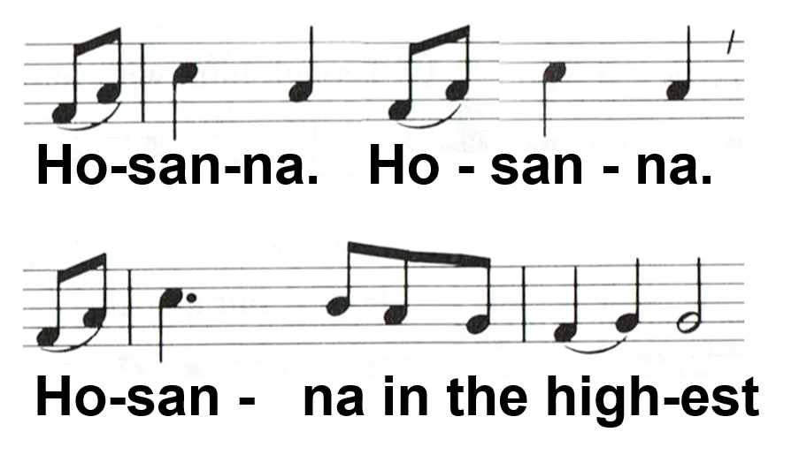

Slide 93
WORDS OF INSTITUTION
Options A or B
[Default: Option A]

Slide 94
WORDS OF INSTITUTION
M: All praise and thanks be to you, eternal God, holy Father, together with your only Son, our Lord Jesus Christ and the Holy Spirit, who unites your people in love. We thank you for creating all things. We thank you for calling and rescuing your chosen people. …
Notes:
WORDS OF INSTITUTION option A part 1

Slide 95
…Above all we thank and praise you for keeping your promise to the people of old and sending your Son Jesus Christ, whose life, death, and resurrection for our salvation we remember as he comes to us in this holy meal.
C: Amen. Come, Lord Jesus.
Notes:
WORDS OF INSTITUTION option A part 2

Slide 96
M: Our Lord Jesus Christ, on the night when he was betrayed, took bread, and when he had given thanks, he broke it and gave it to his disciples, and said. Take and eat; this is † my body, which is given for you. Do this in remembrance of me.
Notes:
WORDS OF INSTITUTION option A part 3

Slide 97
M: In the same way he took the cup, after the supper, and when he had given thanks , he gave it to them, and said, Drink of it, all of you; this is † my blood of the new covenant, which is shed for you for the forgiveness of sins. Do this, as often as you drink it, in remembrance of me.
C: Christ has died. Christ is risen.
Christ will come again.
Notes:
WORDS OF INSTITUTION option A part 4

Slide 98
M: Send us your Holy Spirit to strengthen our faith so that we who receive the body and blood of Christ may live as true members of the body of your Son.
C: Amen. Come, Holy Spirit.
Notes:
WORDS OF INSTITUTION option A part 5

Slide 99
M: Join our prayers with those of your servants of every time and every place, and unite them with the ceaseless petitions of our great high priest until he comes as victorious Lord of all.
Notes:
WORDS OF INSTITUTION option A part 6

Slide 100
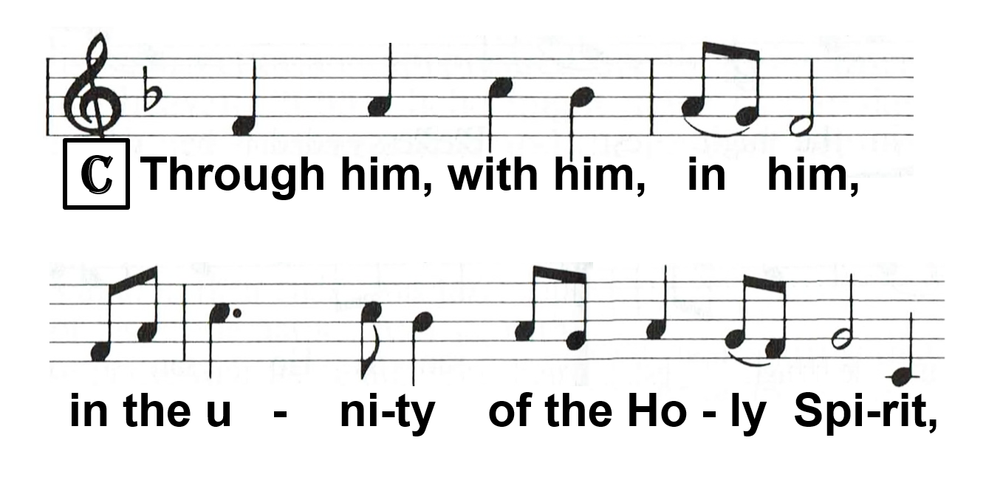
Notes:
WORDS OF INSTITUTION option A part 7

Slide 101
Notes:
WORDS OF INSTITUTION option A part 8

Slide 102
WORDS OF INSTITUTION
M: Our Lord Jesus Christ, on the night when he was betrayed, took bread, and when he had given thanks, he broke it and gave it to his disciples, and said, Take and eat, this is † my body, which is given for you. Do this in remembrance of me. …
Notes:
WORDS OF INSTITUTION option B part 1

Slide 103
…In the same way he took the cup, after the supper, and when he had given thanks, he gave it to them, and said, Drink of it, all of you; this is † my blood of the new covenant, which is shed for you for the forgiveness of sins. Do this, as often as you drink it, in remembrance of me.
Notes:
WORDS OF INSTITUTION option B part 2

Slide 104
THE LORD’S PRAYER
Options A or B (Modern or Traditional)
[Default: Option A]

Slide 105
THE LORD’S PRAYER
M: Our Father in heaven, hallowed be your name, your kingdom come, your will be done, on earth as in heaven. Give us today our daily bread. Forgive us our sins as we forgive those who sin against us. Lead us not into temptation, but deliver us from evil.
C: For the kingdom, the power, and the glory are yours, now and for ever. Amen.
Notes:
LORD’S PRAYER option A - modern

Slide 106
THE LORD’S PRAYER
M: Our Father who art in heaven; hallowed be thy name; thy kingdom come; thy will be done on earth, as it is in heaven. Give us this day our daily bread; and forgive us our trespasses as we forgive those who trespass against us; and lead us not into temptation; but deliver us from evil.
C: For thine is the kingdom, and the power, and the glory, for ever and ever. Amen.
Notes:
LORD’S PRAYER option B - traditional

Slide 107
THE PEACE
M: The peace of the Lord be with you always.
C: Amen.

Slide 111
DISTRIBUTION Take and eat, this is the body of Christ, given for you. Take and drink, this is the blood of Christ, shed for you for the forgiveness of sins.

Slide 112
DISMISSAL
M: The body and blood of our Lord Jesus Christ make you strong in body and soul to life eternal. Go in peace †
C: Amen.

Slide 113
POST-COMMUNION CANTICLE
Options A or B (Lord now let your servant go
OR Thank the Lord and sing his praise
OR an appropriate hymn is sung)
[Default: Option A]

Slide 114
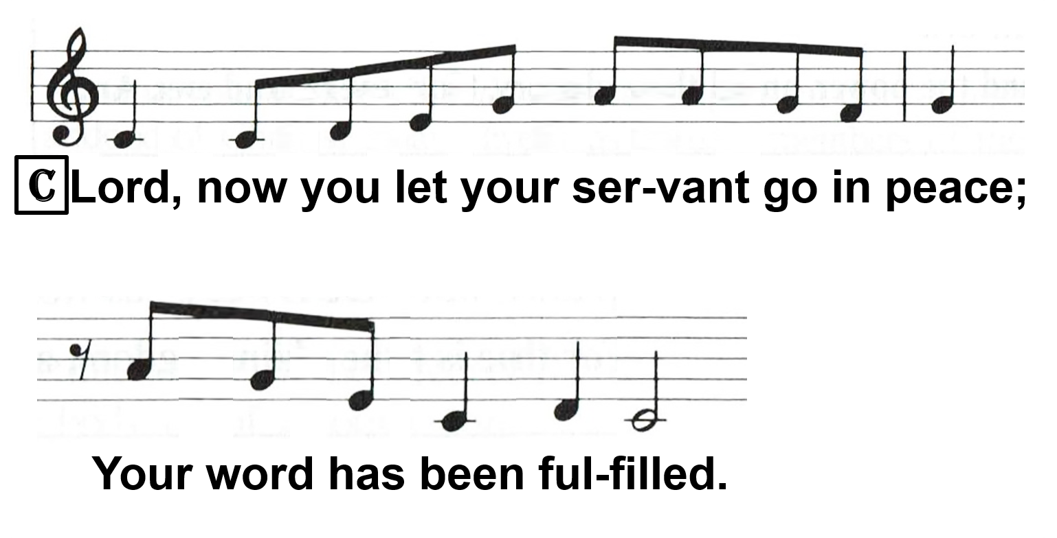
Notes:
POST-COMMUNION CANTICLE option A part 1

Slide 115
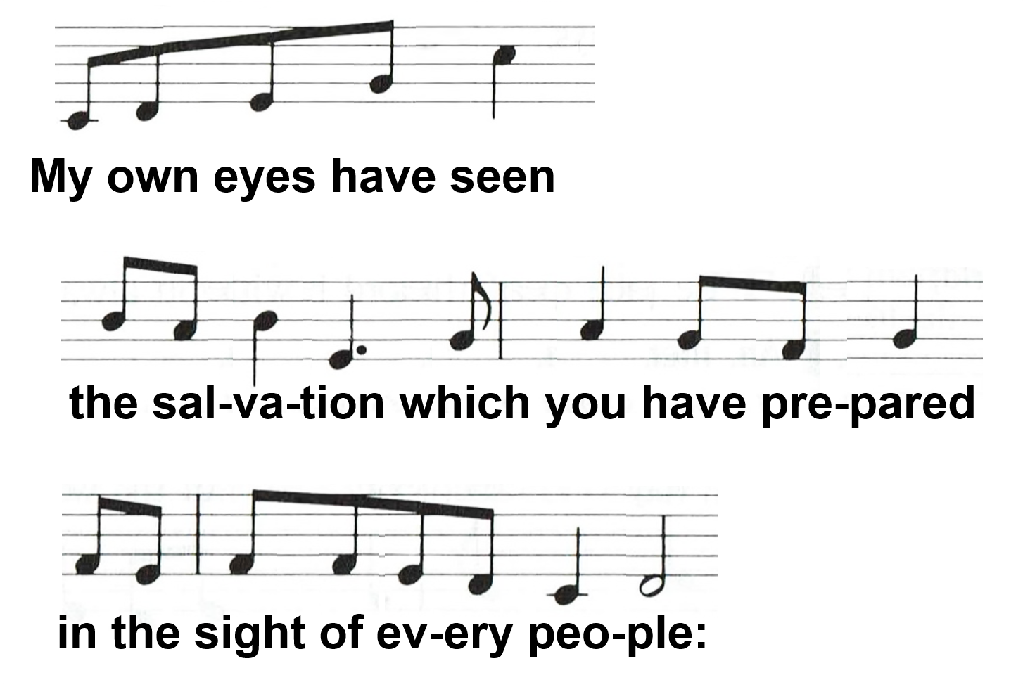
Notes:
POST-COMMUNION CANTICLE option A part 2

Slide 116
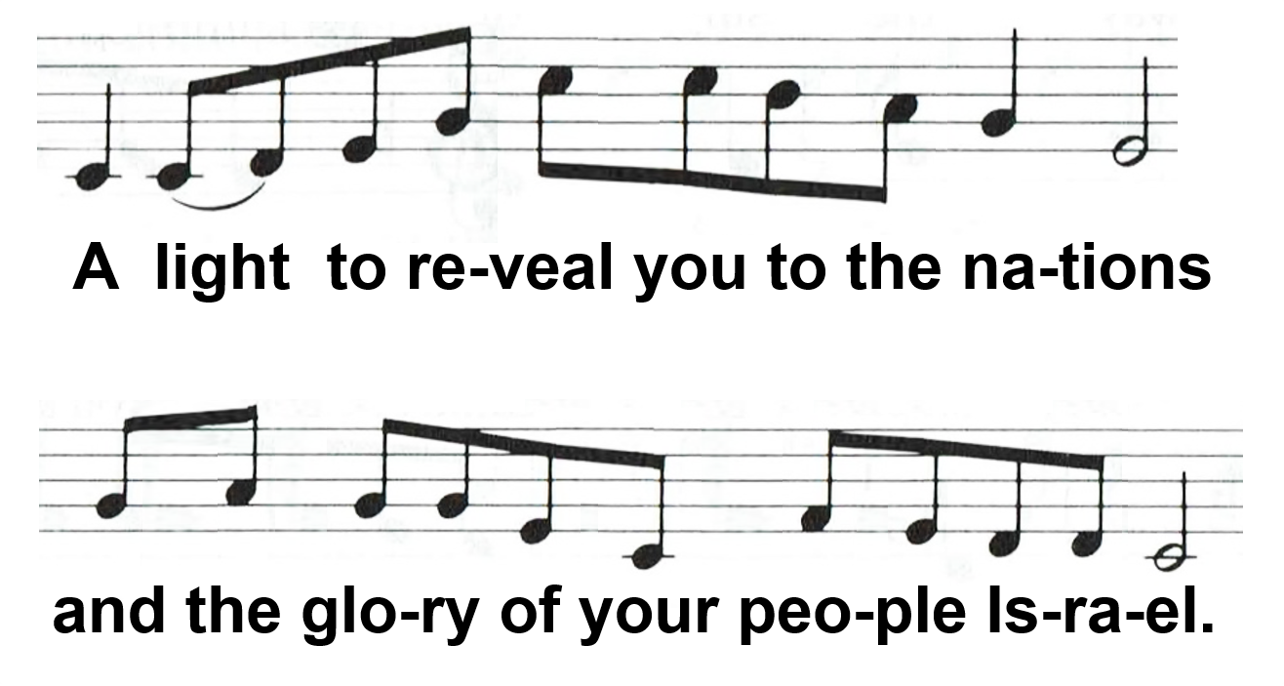
Notes:
POST-COMMUNION CANTICLE option A part 3

Slide 117
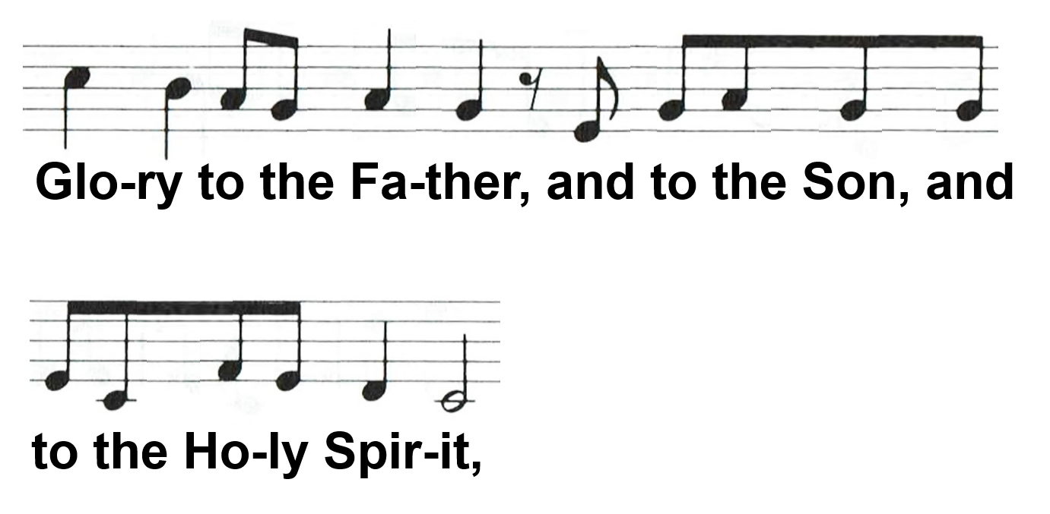
Notes:
POST-COMMUNION CANTICLE option A part 4

Slide 118
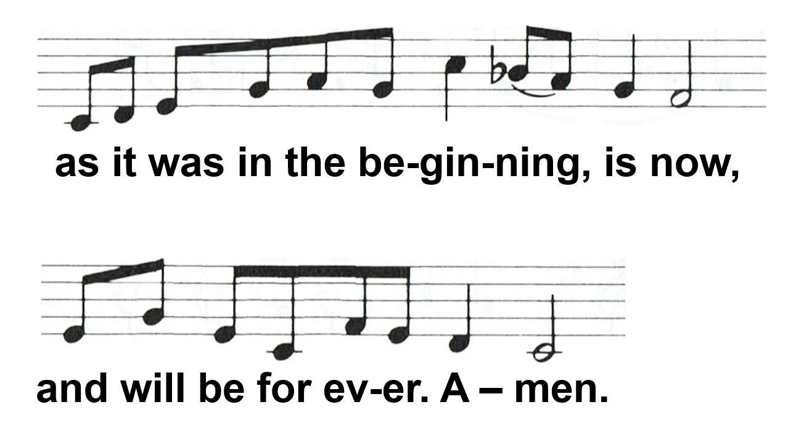
Notes:
POST-COMMUNION CANTICLE option A part 5

Slide 119
Notes:
POST-COMMUNION CANTICLE option B part 1

Slide 120
Notes:
POST-COMMUNION CANTICLE option B part 2

Slide 121
Notes:
POST-COMMUNION CANTICLE option B part 3

Slide 122
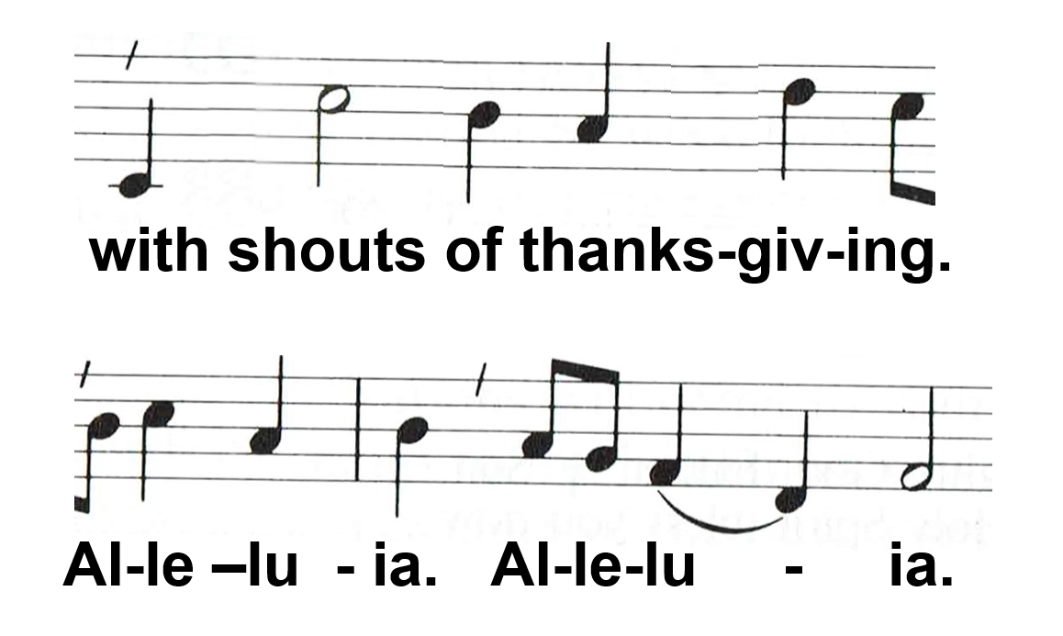
Notes:
POST-COMMUNION CANTICLE option B part 4

Slide 123
CLOSING PRAYER
Options A or B
[Default: Option A]

Slide 124
CLOSING PRAYER
M: Let us pray.
ALL: We give you thanks, almighty God, that you have refreshed us through this healing gift; and we pray that through it you would graciously strengthen us in faith toward you and in love toward one another; …
Notes:
CLOSING PRAYER option A part 1

Slide 125
…through your Son, Jesus Christ our Lord, who lives and reigns with you and the Holy Spirit, one God, now and for ever. Amen.
Notes:
CLOSING PRAYER option A part 2

Slide 126
CLOSING PRAYER
M: Let us pray.
ALL: Heavenly Father, you did not spare your own Son but gave him up for us all: As we have received his body and blood in the Sacrament, let us continually live in him and he in us, so that, as your children, we may walk in your ways and serve you all the days of our life; …
Notes:
CLOSING PRAYER option B part 1

Slide 127
…through the same Jesus Christ our Lord, who lives and reigns with you and the Holy Spirit, one God, now and for ever. Amen.
Notes:
CLOSING PRAYER option B part 2

Slide 128
BLESSING
Options A or B
[Default: Option A]

Slide 129
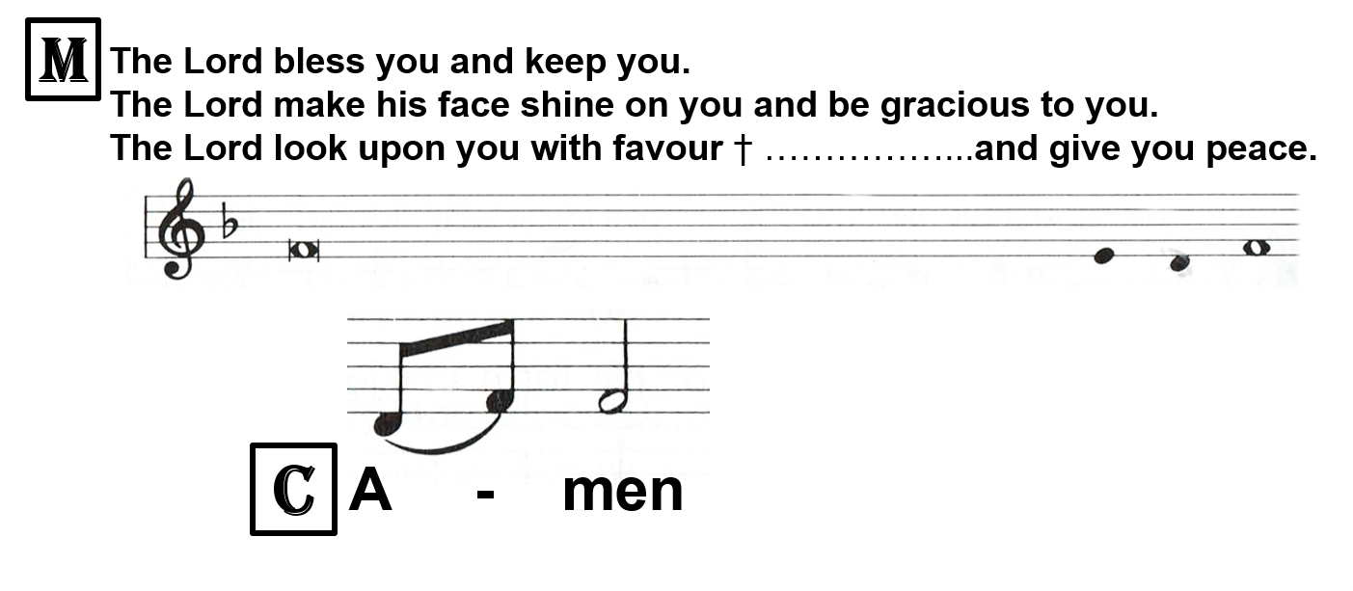
Notes:
BLESSING option A

Slide 130
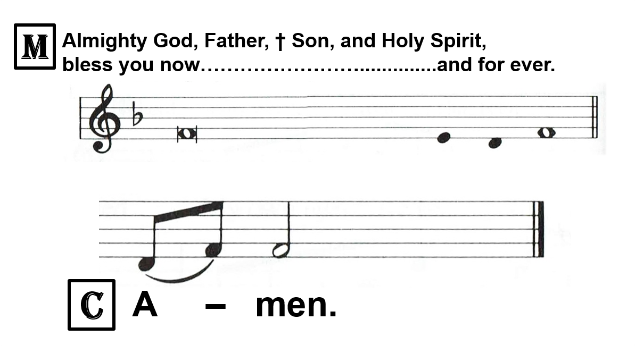
Notes:
BLESSING option B

Slide 131
DOXOLOGY (may be sung)

