Slide 1
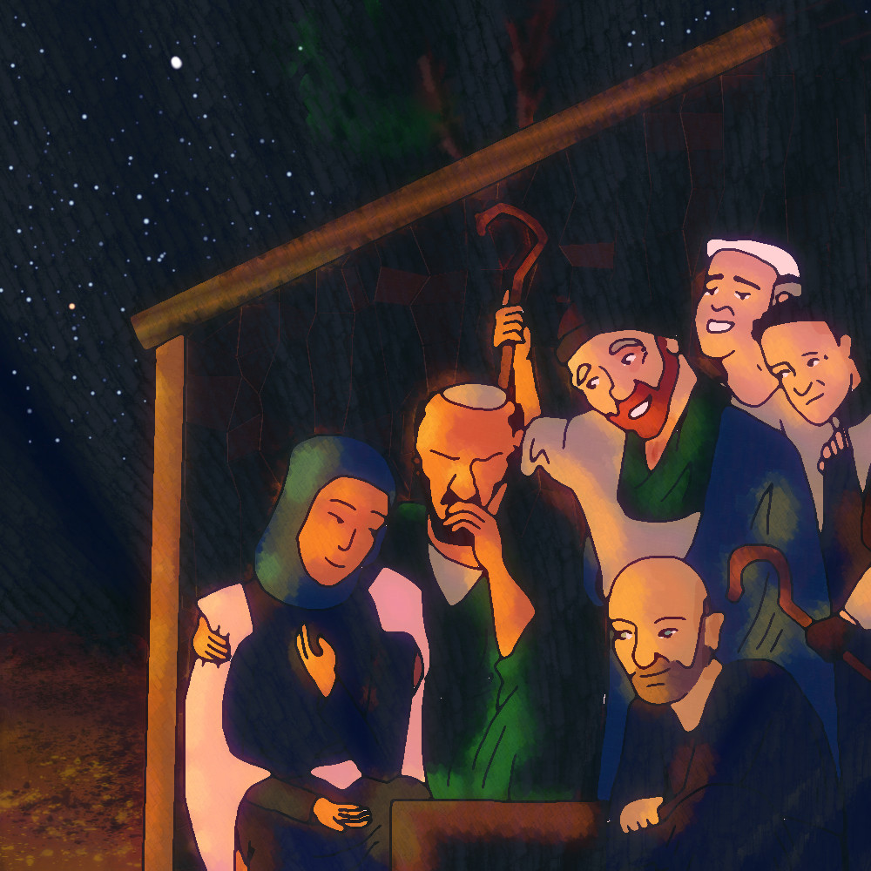
Christmas Lessons and Carols

Slide 2
LH 632 Once in Royal David’s City
Cecil Frances Alexander (1823-1895)

Slide 3
Verse 1
Once in royal David’s city stood a lowly cattle shed, where a mother laid her baby in a manger for his bed; Mary was that mother mild, Jesus Christ her little child.

Slide 4
Verse 2
He came down to earth from heaven who is God and Lord of all, and his shelter was a stable, and his cradle was a stall; with the poor, and meek, and lowly lived on earth our Saviour holy.

Slide 5
Verse 3
And our eyes at last shall see him, through his own redeeming love, for that child so dear and gentle is our Lord in heaven above; and he leads his children on to the place where he is gone.

Slide 6
Verse 4 (Last Verse)
Not in that poor lowly stable,
With the oxen standing by,
We shall see him; but in heaven,
Set at God’s right hand on high;
Where like stars his children crowned
All in white shall wait around.

Slide 8
Friends in Christ:
Let us hear again the message of the angels, and in heart and mind go to Bethlehem and see the loving-kindness of our God, and the baby lying in a manger.

Slide 9
Let us hear in holy Scripture the story of the loving purposes of God from the first days of our disobedience to the glorious redemption gained for us by the holy child, Jesus Christ our Lord; and let us thank him with our carols of praise.

Slide 10
But first let us pray to God for the needs of the whole world. Heavenly Father, bring peace and goodwill among all people, so that we may learn to love one another, as your children.

Slide 11
Look in mercy on the poor and helpless; the homeless, the hungry, and the oppressed; the sick and those who mourn; the lonely and the unloved; the aged and the little children; and all those who do not know or love the Lord Jesus, or who by sin have grieved his heart.

Slide 12
We come before you with all those who rejoice with us in a greater light, that heavenly multitude which none of us can number, with whom, in the Lord Jesus, we are one for evermore.
In his name we now pray:

Slide 13
Our Father in heaven, hallowed be your name, your kingdom come, your will be done, on earth as in heaven. Give us today our daily bread. Forgive us our sins as we forgive those who sin against us. Lead us not into temptation, but deliver us from evil. For the kingdom, the power, and the glory are yours now and forever. Amen.

Slide 14
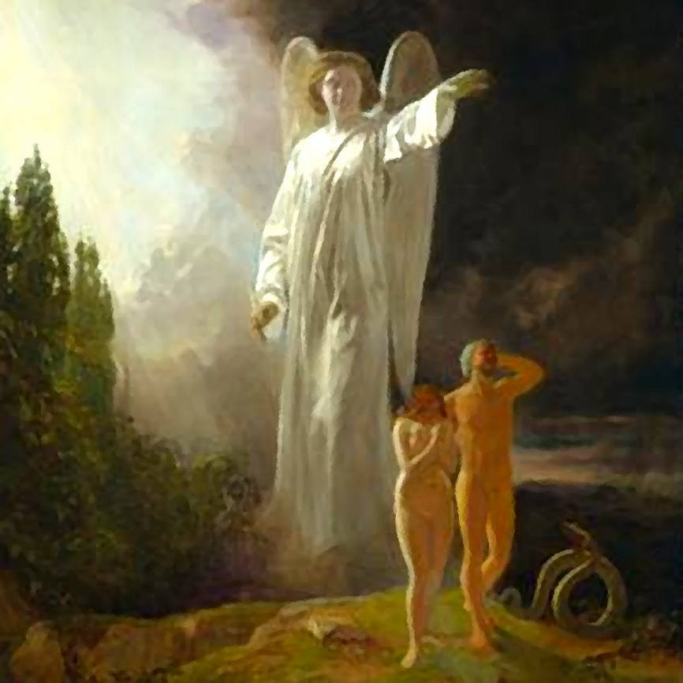
First Reading
Genesis 3:8-15
God announces in the Garden of Eden that the offspring of the woman will crush the serpent's head.

Slide 15
Then the man and his wife heard the sound of the Lord God as he was walking in the garden in the cool of the day, and they hid from the Lord God among the trees of the garden. But the Lord God called to the man, ‘Where are you?’
He answered, ‘I heard you in the garden, and I was afraid because I was naked; so I hid.’

Slide 16
And he said, ‘Who told you that you were naked? Have you eaten from the tree from which I commanded you not to eat?’
The man said, ‘The woman you put here with me – she gave me some fruit from the tree, and I ate it.’
Then the Lord God said to the woman, ‘What is this you have done?’

Slide 17
The woman said, ‘The snake deceived me, and I ate.’
So the Lord God said to the snake, ‘Because you have done this,
‘Cursed are you above all livestock and all wild animals! You will crawl on your belly and you will eat dust all the days of your life.

Slide 18
And I will put enmity between you and the woman, and between your offspring and hers; he will crush your head, and you will strike his heel.’

Slide 19
LHB 17 Come, thou long expected Jesus
Charles Wesley (1707-1788)

Slide 20
Verse 1
Come, thou long expected Jesus,
born to set thy people free;
from our fears and sins release us,
let us find our rest in thee.

Slide 21
Verse 2
Israel's strength and consolation, hope of all the earth thou art; dear desire of every nation, joy of every longing heart.

Slide 22
Verse 3
Born thy people to deliver,
born a child and yet a King,
born to reign in us forever,
now thy gracious kingdom bring.

Slide 23
Verse 4 (Last Verse)
By thine own eternal spirit
rule in all our hearts alone;
by thine all sufficient merit,
raise us to thy glorious throne.

Slide 24
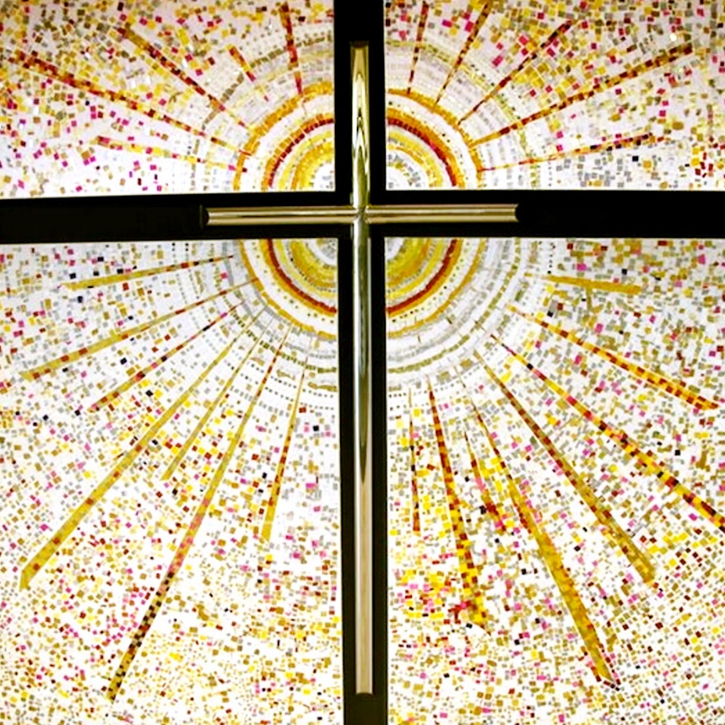
Second Reading
Isaiah 9:2,6,7
The prophet Isaiah foretells Christ's birth and kingdom.

Slide 25
The people walking in darkness have seen a great light; on those living in the land of deep darkness a light has dawned.
For to us a child is born, to us a son is given, and the government will be on his shoulders. And he will be called Wonderful Counsellor, Mighty God, Everlasting Father, Prince of Peace.

Slide 26
Of the greatness of his government and peace there will be no end. He will reign on David’s throne and over his kingdom, establishing and upholding it with justice and righteousness from that time on and for ever. The zeal of the Lord Almighty will accomplish this.

Slide 27
LH 9 Hark the Glad Sound
Philip Doddridge (1702-1751)

Slide 28
Verse 1
Hark, the glad sound!
The Saviour comes,
the Saviour promised long!
Let every heart prepare a throne,
and every voice a song.

Slide 29
Verse 2
He comes the prisoners to release,
in Satan’s bondage held;
the gates of brass before Him burst,
the iron fetters yield.

Slide 30
Verse 3
He comes the broken heart to bind,
the bleeding soul to cure,
and with the treasures of His grace,
to enrich the humbled poor.

Slide 31
Verse 4 (Last Verse)
Our glad Hosannas, Prince of Peace,
Thy welcome shall proclaim;
and heaven’s eternal arches ring,
with Thy beloved Name.

Slide 32
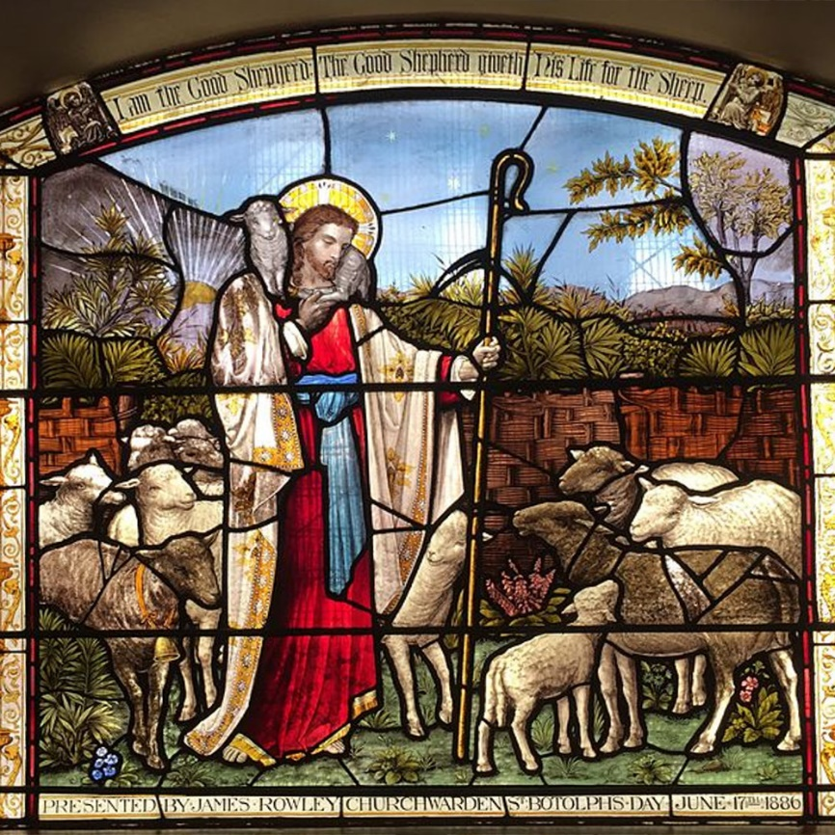
Third Reading
Micah 5:2-5a
The prophet announces the
birthplace of the Saviour.

Slide 33
‘But you, Bethlehem Ephrathah,
though you are small among the clans of Judah,
out of you will come for me
one who will be ruler over Israel,
whose origins are from of old,
from ancient times.’
Therefore Israel will be abandoned
until the time when she who is in labour bears a son,

Slide 34
and the rest of his brothers return
to join the Israelites.
He will stand and shepherd his flock
in the strength of the LORD,
in the majesty of the name of the LORD his God.
And they will live securely, for then his greatness will reach to the ends of the earth.
And he will be our peace
when the Assyrians invade our land
and march through our fortresses.

Slide 35
LH 633 O little town of Bethlehem
Phillips Brooks (1835-1893)

Slide 36
Verse 1
O little town of Bethlehem,
how still we see you lie!
Above your deep and dreamless sleep
the silent stars go by;
yet in your dark streets shining
the everlasting Light;
the hopes and fears of all the years
are met in you tonight.

Slide 37
Verse 2
For Christ is born of Mary:
and, gathered all above,
while mortals sleep, the angels keep
their watch of wondering love.
O morning stars, together
proclaim the holy birth,
and praises sing to God the king,
and peace to all on earth.

Slide 38
Verse 3
How silently, how silently,
the wondrous gift is given!
So God imparts to human hearts
the blessings of his heaven.
No ear may hear his coming;
but in this world of sin,
where meek souls will receive him, still
the dear Christ enters in.

Slide 39
Verse 4 (Last Verse)
O holy child of Bethlehem,
descend to us we pray;
cast out our sin, and enter in:
be born in us today.
We hear the Christmas angels
The great glad tidings tell;
O come to us, abide with us,
our Lord Immanuel!

Slide 40
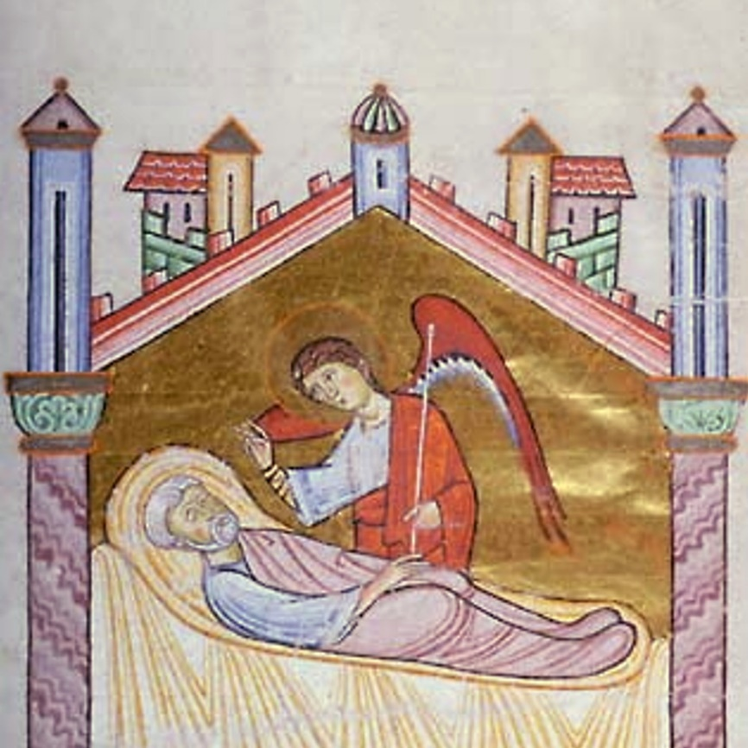
Fourth Reading
Matthew 1:18-25
Matthew tells of the birth of Jesus.

Slide 41
This is how the birth of Jesus the Messiah came about: his mother Mary was pledged to be married to Joseph, but before they came together, she was found to be pregnant through the Holy Spirit. Because Joseph her husband was faithful to the law, and yet did not want to expose her to public disgrace, he had in mind to divorce her quietly.

Slide 42
But after he had considered this, an angel of the Lord appeared to him in a dream and said, ‘Joseph son of David, do not be afraid to take Mary home as your wife, because what is conceived in her is from the Holy Spirit. She will give birth to a son, and you are to give him the name Jesus, because he will save his people from their sins.’

Slide 43
All this took place to fulfil what the Lord had said through the prophet: ‘The virgin will conceive and give birth to a son, and they will call him Immanuel’ (which means ‘God with us’).
When Joseph woke up, he did what the angel of the Lord had commanded him and took Mary home as his wife. But he did not consummate their marriage until she gave birth to a son. And he gave him the name Jesus.

Slide 44
LH 2 O Come, O come Immanuel
From the Great O Antiphons, 12th-13th century, Tr. John Mason Neale, 1851/1859.

Slide 45
Verse 1
O come, O come, Immanuel,
and ransom captive Israel,
that mourns in lonely exile here,
until the Son of God appear.
Rejoice! Rejoice! Immanuel
shall come to you, O Israel.

Slide 46
Verse 2
O come, Thou rod of Jesse, free
Thine own from Satan’s tyranny;
from depth of hell Thy people save,
and give them victory o’er the grave.
Rejoice! Rejoice! Immanuel
shall come to you, O Israel.

Slide 47
Verse 3
O come, Thou dayspring, come
and cheer
our spirits by Thine advent here;
disperse the gloomy clouds of night,
and death’s dark shadows put
to flight.
Rejoice! Rejoice! Immanuel
shall come to you, O Israel.

Slide 48
Verse 4 (Last Verse)
O come, Thou key of David, come
and open wide our heavenly home.
Make safe the path that leads on high,
and close the path to misery.
Rejoice! Rejoice! Immanuel
shall come to you, O Israel.

Slide 49
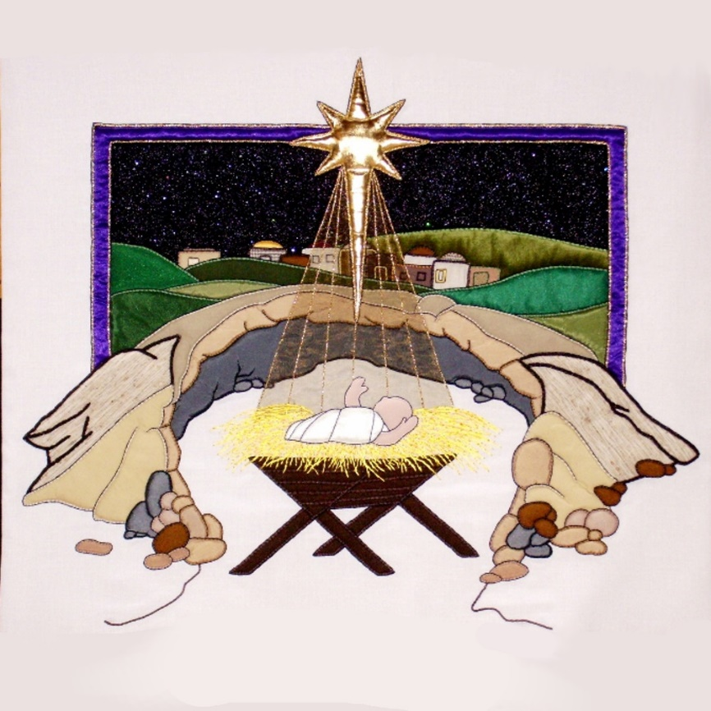
Fifth Reading
Luke 2:1-7
Luke tells of the birth of the Christ child.

Slide 50
In those days a decree went out from Emperor Augustus that all the world should be registered. This was the first registration and was taken while Quirinius was governor of Syria. All went to their own towns to be registered. Joseph also went from the town of Nazareth in Galilee to Judea, to the city of David called Bethlehem, because he was descended from the house and family of David.

Slide 51
He went to be registered with Mary, to whom he was engaged and who was expecting a child. While they were there, the time came for her to deliver her child. And she gave birth to her firstborn son and wrapped him in bands of cloth, and laid him in a manger, because there was no place for them in the inn.

Slide 52
LH 23 From heaven above to earth I come
Martin Luther (1483-1546), Tr. Catherine Winkworth, 1855, alt.

Slide 53
Verse 1
From heaven above to earth I come,
To bear good news to every home;
Glad tidings of great joy I bring,
Whereof I now will say and sing.

Slide 54
Verse 2
To you, this night, is born a Child
Of Mary, chosen virgin mild;
This little child of lowly birth,
Shall be the joy of all your earth.

Slide 55
Verse 3
This is the Christ our God and Lord,
who in all need shall aid afford;
He will himself your Saviour be,
From all your sins to set you free.

Slide 56
Verse 4
He brings those blessings long ago
Prepared by God for all below;
That in His kingdom bright and fair
You may with us his glory share

Slide 57
Verse 5
These are the tokens ye shall mark,
The swaddling clothes and manger dark;
There shall ye find the young child laid,
By whom the heavens and earth were made.

Slide 58
Verse 6
Now let us all, with gladsome cheer,
Follow the shepherds, and draw near
To see this wondrous gift of God,
Who hath His own dear Son bestowed.

Slide 59
Verse 7 (Last Verse)
Give heed, my heart, lift up thine eyes!
Who is it in yon manger lies?
Who is this child, so young and fair?
The blessèd Christ-child lieth there!

Slide 60
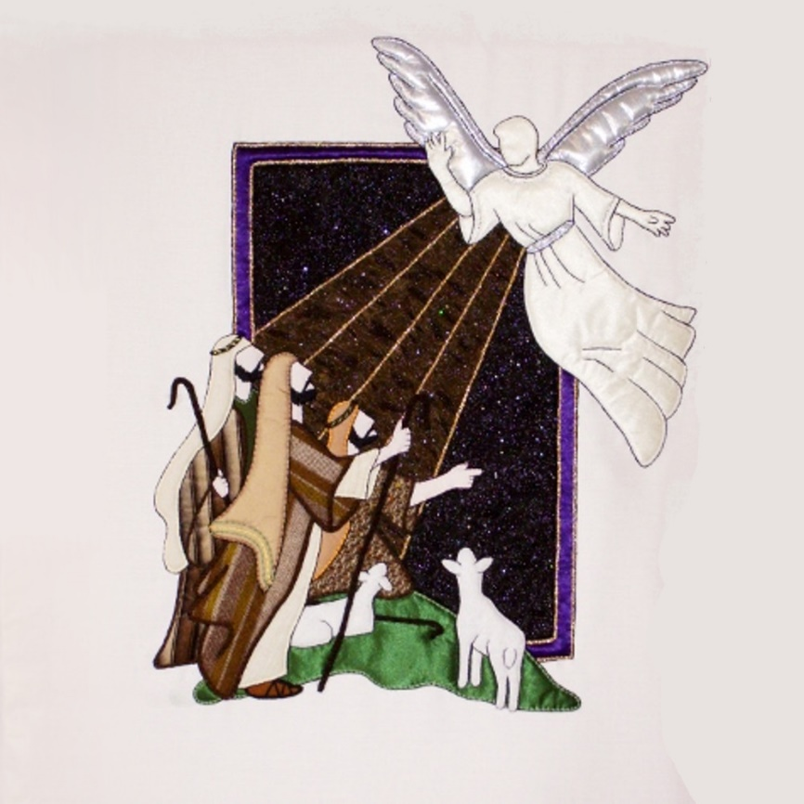
Sixth Reading
Luke 2:8-12
The shepherds are told of the birth of Jesus.

Slide 61
And there were shepherds living out in the fields near by, keeping watch over their flocks at night. An angel of the Lord appeared to them, and the glory of the Lord shone around them, and they were terrified. But the angel said to them, ‘Do not be afraid. I bring you good news that will cause great joy for all the people. Today in the town of David a Saviour has been born to you; he is the Messiah, the Lord.

Slide 62
This will be a sign to you: you will find a baby wrapped in cloths and lying in a manger.’

Slide 63
LH 629 Silent Night
Josef Mohr (1792-1848), Tr. Anonymous, 1871

Slide 64
Verse 1
Silent night, holy night!
All is calm, all is bright
round yon virgin mother and child.
Holy infant, so tender and mild,
sleep in heavenly peace.

Slide 65
Verse 2
Silent night, holy night!
Shepherds quake at the sight,
glory streams from heaven afar,
heavenly hosts sing: Hallelujah!
Christ the Saviour is born.

Slide 66
Verse 3 (Last Verse)
Silent night, holy night!
Son of God, love’s pure light
radiant beams from thy holy face,
with the dawn of redeeming grace,
Jesus, Lord, at thy birth.

Slide 67
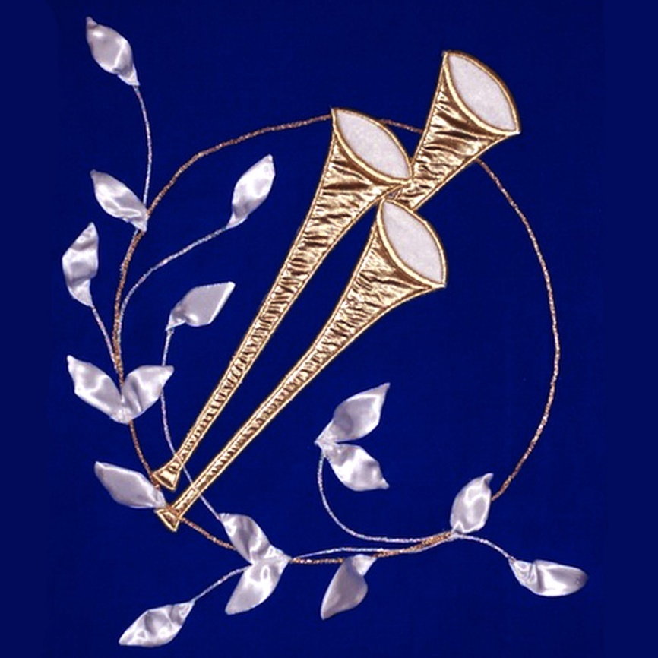
Seventh Reading
Luke 2:13-20
The angels proclaim peace, and the shepherds go to Bethlehem.

Slide 68
Suddenly a great company of the heavenly host appeared with the angel, praising God and saying,
‘Glory to God in the highest heaven,
and on earth peace to those on whom his favour rests.’
When the angels had left them and gone into heaven, the shepherds said to one another, ‘Let’s go to Bethlehem and see this thing that has happened, which the Lord has told us about.’

Slide 69
So they hurried off and found Mary and Joseph, and the baby, who was lying in the manger. When they had seen him, they spread the word concerning what had been told them about this child, and all who heard it were amazed at what the shepherds said to them. But Mary treasured up all these things and pondered them in her heart.

Slide 70
The shepherds returned, glorifying and praising God for all the things they had heard and seen, which were just as they had been told.

Slide 71
LH 33 Hark! the herald angels sing
Charles Wesley (1707-1788), revised by George Whitefield (1714-1770), Martin Madan (1726-1790) and others.

Slide 72
Verse 1
Hark! The herald angels sing
glory to the new-born King;
peace on earth, and mercy mild,
God and sinners reconciled.
Joyful, all you nations, rise,
join the triumph of the skies;
with the angelic host proclaim:
Christ is born in Bethlehem.

Slide 73
Hark! the herald angels sing
glory to the new-born King.

Slide 74
Verse 2
Christ, by highest heaven adored, Christ, the everlasting Lord, late in time behold him come, offspring of a virgin’s womb.
Veiled in flesh the Godhead see;
Hail, the incarnate Deity, pleased as man with us to dwell, Jesus, our Immanuel:

Slide 75
Hark! the herald angels sing
glory to the new-born King.

Slide 76
Verse 3 (Last Verse)
Hail, the heaven-born Prince of peace!
Hail, the sun of righteousness!
Light and life to all he brings, risen with healing in his wings.
Mild he lays his glory by,
born that we no more may die, born to raise the sons of earth, born to give them second birth:

Slide 77
Hark! the herald angels sing
glory to the new-born King.

Slide 78
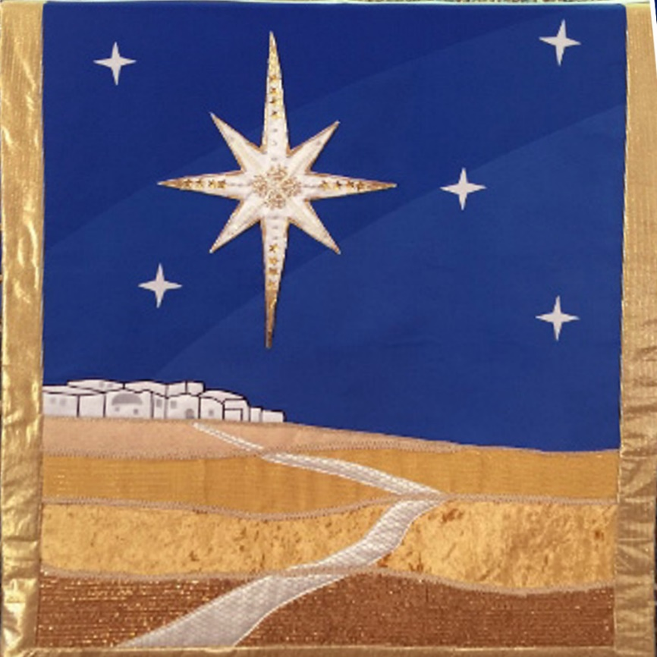
Eighth Reading
Matthew 2:1-11
The wise men are led by the star to Jesus.

Slide 79
After Jesus was born in Bethlehem in Judea, during the time of King Herod, Magi from the east came to Jerusalem and asked, ‘Where is the one who has been born king of the Jews? We saw his star when it rose and have come to worship him.’

Slide 80
When King Herod heard this he was disturbed, and all Jerusalem with him. When he had called together all the people’s chief priests and teachers of the law, he asked them where the Messiah was to be born.
‘In Bethlehem in Judea,’ they replied, ‘for this is what the prophet has written:

Slide 81
‘“But you, Bethlehem, in the land of Judah, are by no means least among the rulers of Judah;
for out of you will come a ruler
who will shepherd my people Israel.”’
Then Herod called the Magi secretly and found out from them the exact time the star had appeared. He sent them to Bethlehem and said, ‘Go and search carefully for the child. As soon as you find him, report to me, so that I too may go and worship him.’

Slide 82
After they had heard the king, they went on their way, and the star they had seen when it rose went ahead of them until it stopped over the place where the child was. When they saw the star, they were overjoyed. On coming to the house, they saw the child with his mother Mary, and they bowed down and worshipped him. Then they opened their treasures and presented him with gifts of gold, frankincense and myrrh.

Slide 83
LH 40 As with gladness men of old
William Chatterton Dix (1837-1898), alt.

Slide 84
Verse 1
As with gladness, men of old
Did the guiding star behold
As with joy they hailed its light
Leading onward, beaming bright
So, most glorious Lord, may we
Evermore be led to Thee.

Slide 85
Verse 2
As with joyful steps they sped
To that lowly manger bed
There to bend the knee before
Him Whom Heaven and earth adore;
So may we with willing feet
Ever seek Thy mercy seat.

Slide 86
Verse 3 (Last Verse)
As they offered gifts most rare
At that manger rude and bare;
So may we with holy joy,
Pure and free from sin’s alloy,
All our costliest treasures bring,
Christ, to Thee, our heavenly King.

Slide 87
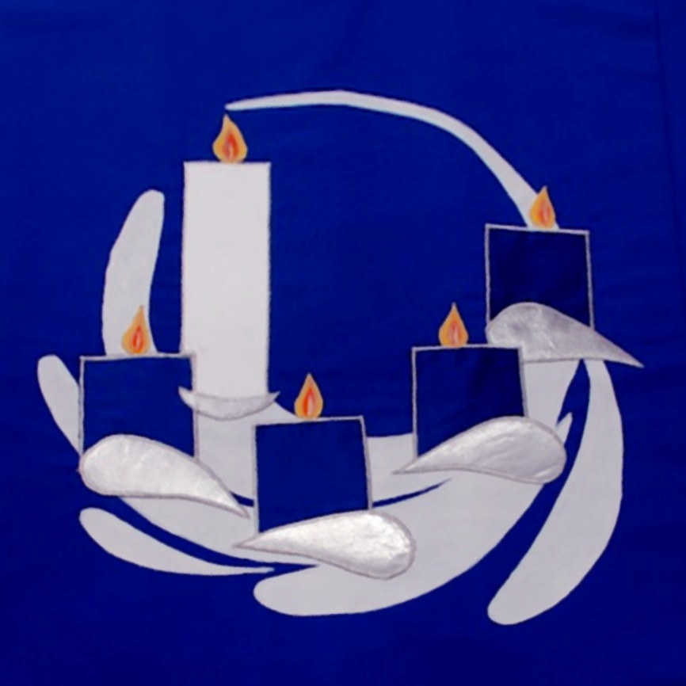
Ninth Reading
John 1:1-4, 14
John describes the mystery of the incarnation.

Slide 88
In the beginning was the Word, and the Word was with God, and the Word was God. He was in the beginning with God. All things came into being through him, and without him not one thing came into being. What has come into being in him was life, and the life was the light of all people.

Slide 89
And the Word became flesh and lived among us, and we have seen his glory, the glory as of a father’s only son, full of grace and truth.

Slide 90
LH 627 Joy to the world
Isaac Watts (1674-1748)

Slide 91
Verse 1
Joy to the world! The Lord has come;
let earth receive her king;
let every heart prepare him room,
and heaven and nature sing.

Slide 92
Verse 2
Joy to the world! The Saviour reigns; let all their songs employ; while fields and floods, rocks, hills and plains repeat the sounding joy.

Slide 93
Verse 3
No more let sins and sorrows grow,
nor thorns infest the ground;
He comes to make his blessings flow
far as the curse is found.

Slide 94
Verse 4 (Last Verse)
He rules the world with truth and grace,
and makes the nations prove
the glories of his righteousness,
and wonders of his love.

Slide 96
The Lord be with you. And also with you. Let us pray for true Christmas joy.

Slide 97
Lord God,
we thank you for making this holy night shine with the true light of your Son.
As we celebrate his birth as a human child, fill us with the joy of heaven.
For he lives and reigns with you and the Holy Spirit, one God, now and forever.
Amen.

Slide 98
Blessing
Christ the Son of God give you joy and peace by his presence with you; and the blessing of almighty God, Father, Son, and Holy Spirit, be with you always. Amen.

Slide 99
LH 34 O come, all ye faithful
Latin hymn, before 18th century, tr. Frederick Oakeley, 1852, alt.

Slide 100
Verse 1
O come, all ye faithful,
Joyful and triumphant,
O come ye, O come ye to Bethlehem;
Come and behold him,
Born the King of angels:

Slide 101
O come, let us adore Him,
O come, let us adore Him,
O come, let us adore Him,
Christ the Lord!

Slide 102
Verse 2
God of God,
Light of light,
Lo, he abhors not the virgin’s womb;
Very God,
Begotten, nor created:

Slide 103
O come, let us adore Him,
O come, let us adore Him,
O come, let us adore Him,
Christ the Lord!

Slide 104
Verse 3
Sing, choirs of angels, Sing in exultation,
Sing, all ye citizens of heaven above;
Glory to God
In the highest:

Slide 105
O come, let us adore Him,
O come, let us adore Him,
O come, let us adore Him,
Christ the Lord!

