Slide 1
Grace…. a gift and a challenge

Slide 2
?? BE CURIOUS NOT FURIOUS ?? ​

Slide 3
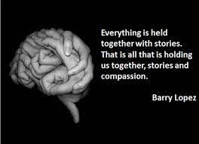
The Power of Story

Slide 4
What Happens in Me When I Hear Your Story?
5 Things that Happen Inside of Us When We Hear Others’ Stories:
1. Our Attention is Focused.
2. Our empathy and compassion increases.
3. Our behaviour is changed.
4. Relational trust and connection are built.
5. Barriers and differences between us are removed.

Slide 5
What happened next? How did that make you feel? Can you tell me more?

Slide 6
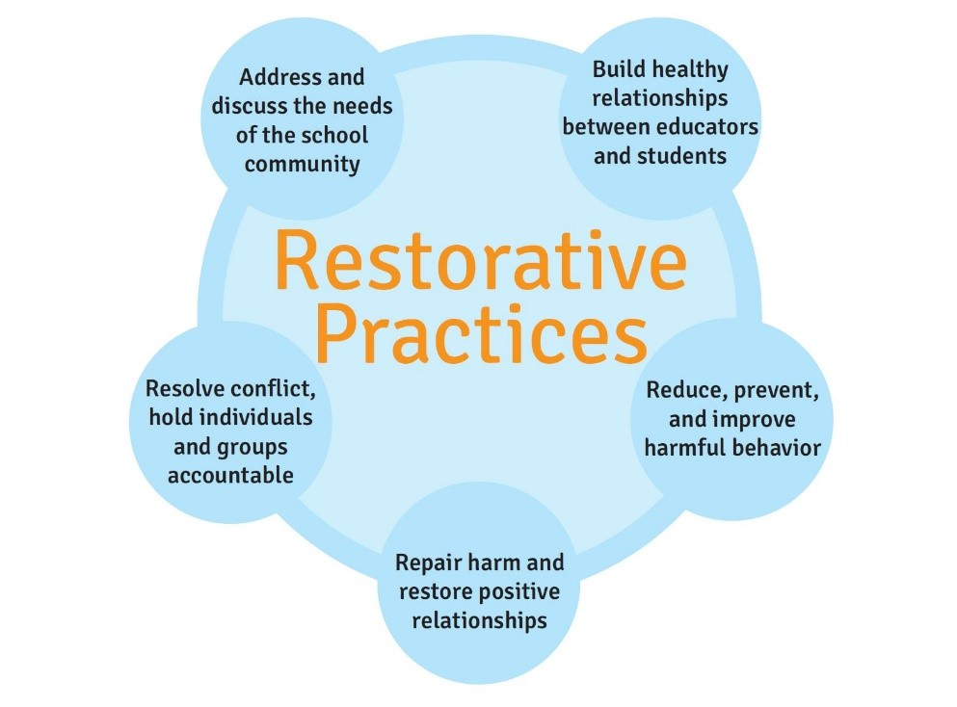

Slide 7
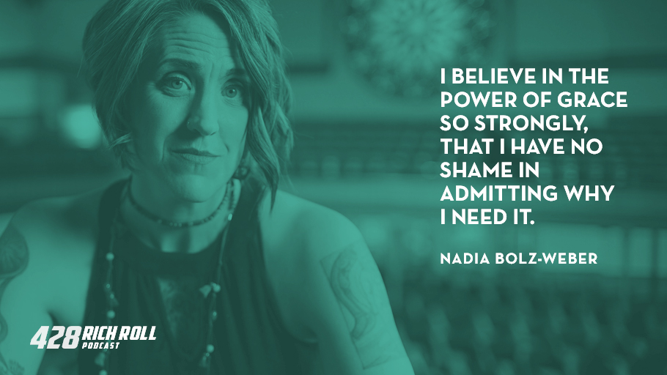

Slide 9
