Slide 2
ALWS
Martin Scharnke:
Community Engagement – Churches and Schools

Slide 3
ALWS: What?
Gifts of Grace catalogues with terrible puns

Slide 4
ALWS:
What?
Christmas Action appeal

Slide 5
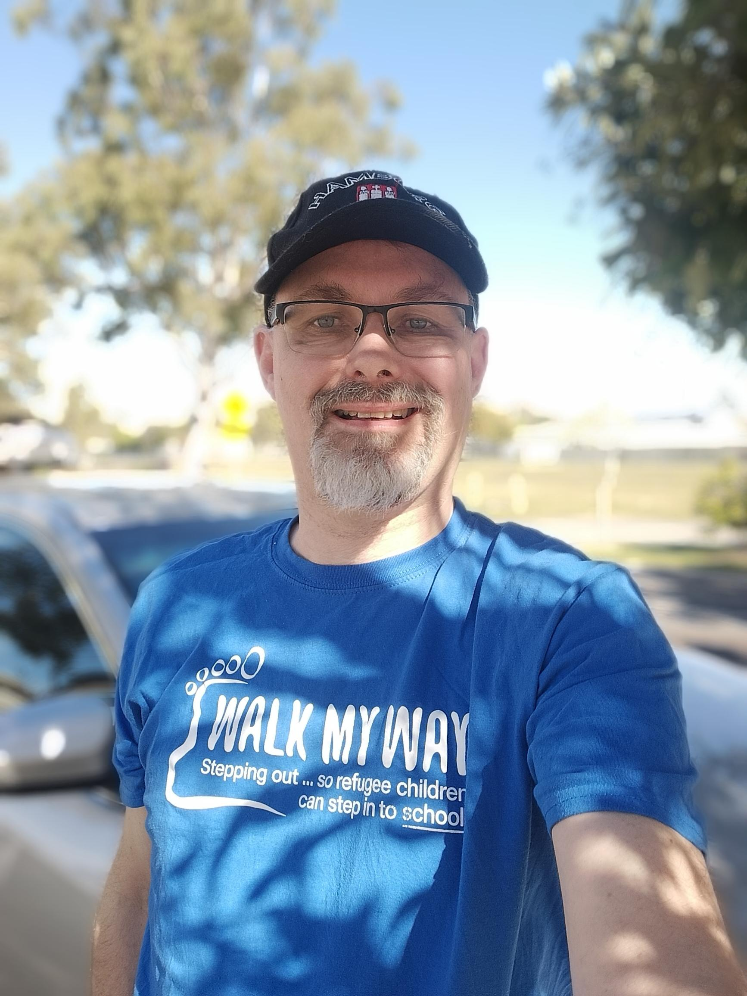
ALWS: What?
Walk My Way

Slide 6
ALWS: Who?
A good friend
A long-lost cousin
Part of you, working for justice
Doing the work of the Gospel – Matthew 25; James 2

Slide 7
ALWS: Our Mission
ALWS reaches out in love, for justice. We bring together people willing to work in service to help end suffering. As partners, we work openly and accountably, supporting programs which welcome, respect and bring hope through care to those fleeing from, or hurt by, disaster, conflict, poverty or oppression. We add our voice to the voices of those unheard and excluded, together crying out for justice so that we can all live in just and sustainable communities.

Slide 8
ALWS & LCAQD
We are for many Lutherans in Queensland the Overseas Aid and Development Agency of Choice – Thank you!
We value the trust you have in us – Thank you!
We want to keep doing important work together – Thank you!

Slide 9
What now?
Listen to ED Michael Stolz: Synod Dinner Saturday
Learn about the many ways we help
Subscribe to regular email Hope Spots
Have us to visit
Be inspired to ACTION!

