Slide 1
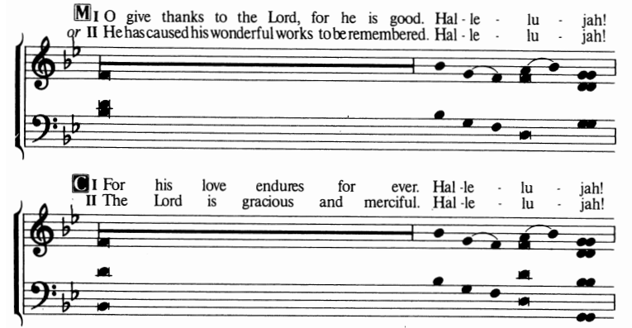
The Thanksgiving

