Slide 1
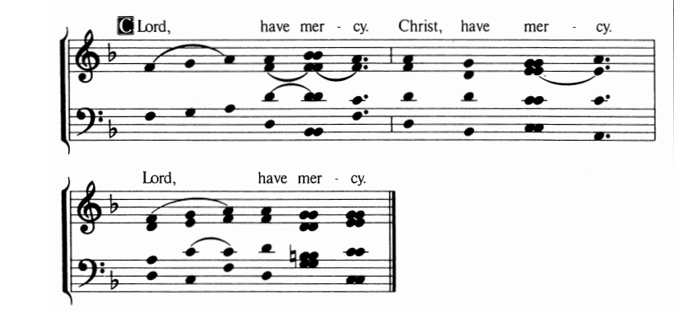
Lord Have Mercy

