Slide 1
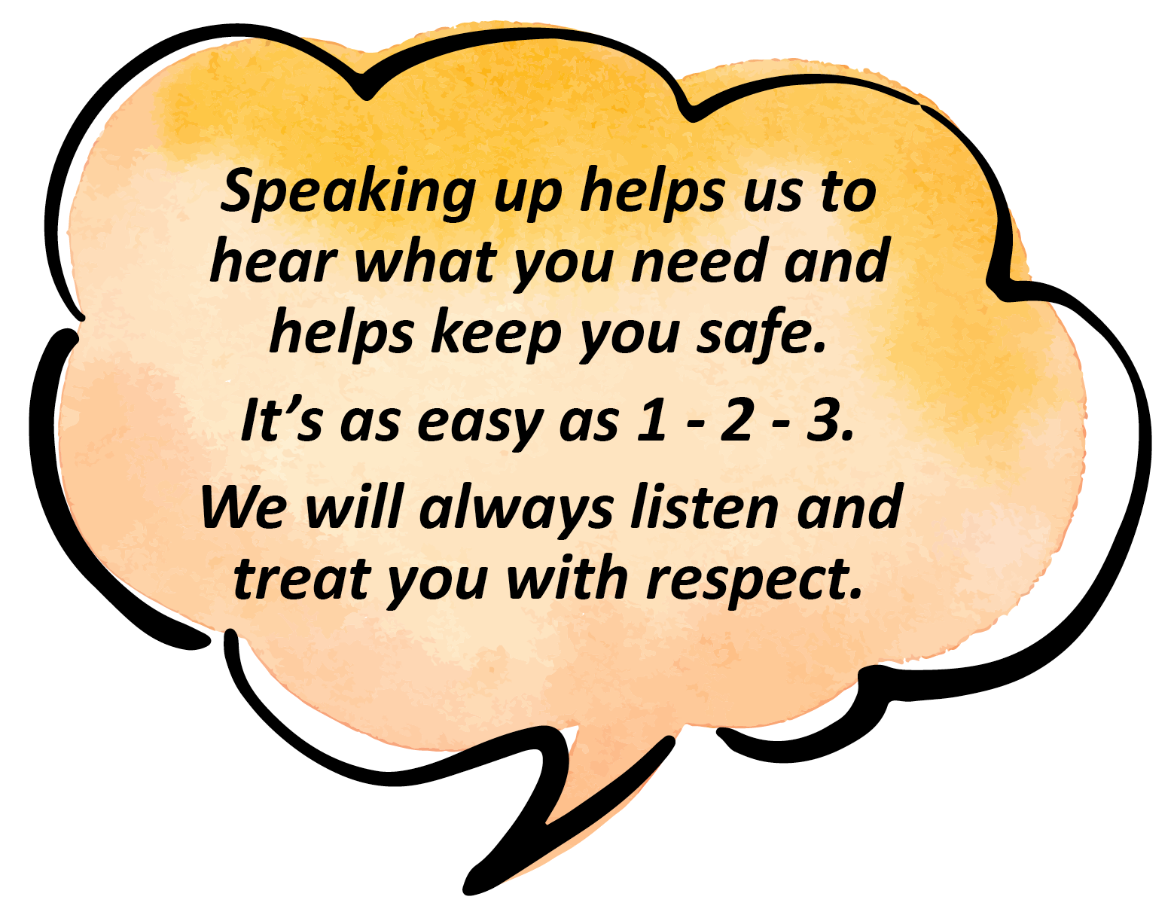

Slide 2
Find a safe person – someone you trust.

Slide 3
Tell your safe person how you feel,
why you don’t feel safe and
what might help you

Slide 4
Make your complaint with your safe person or by yourself to any of the following places

Slide 5
INSERT NAME HERE…..
INSERT PHONE NUMBER HERE…..

