Slide 1
Listening to Children
This is what you should be hearing from children to determine whether your organisation is safe
This is what you should be hearing from children to determine whether your organisation is safe
Notes:
This slide has a flattened background, and only includes components that are animated

Slide 2
Notes:
This slide has a flattened background, and only includes components that are animated

Slide 3
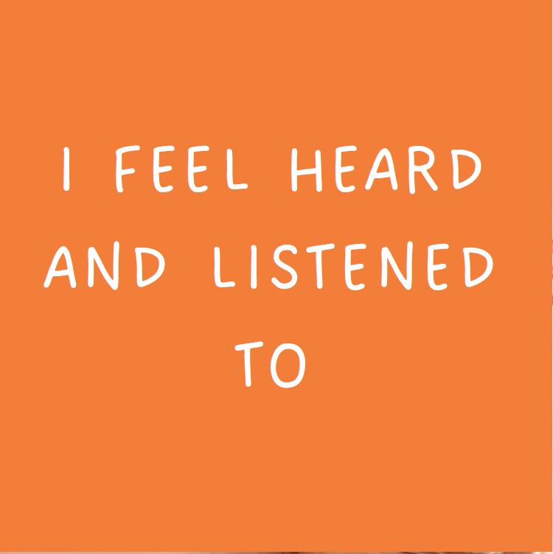
Notes:
This slide has a flattened background, and only includes components that are animated

Slide 4
Notes:
This slide has a flattened background, and only includes components that are animated

Slide 5
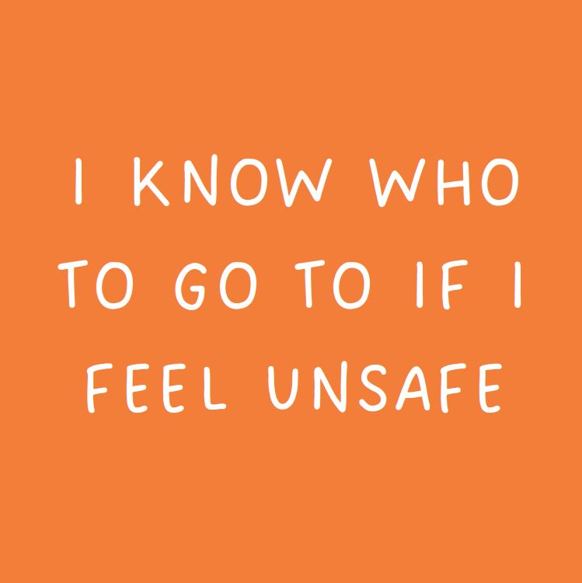
Notes:
This slide has a flattened background, and only includes components that are animated

Slide 6
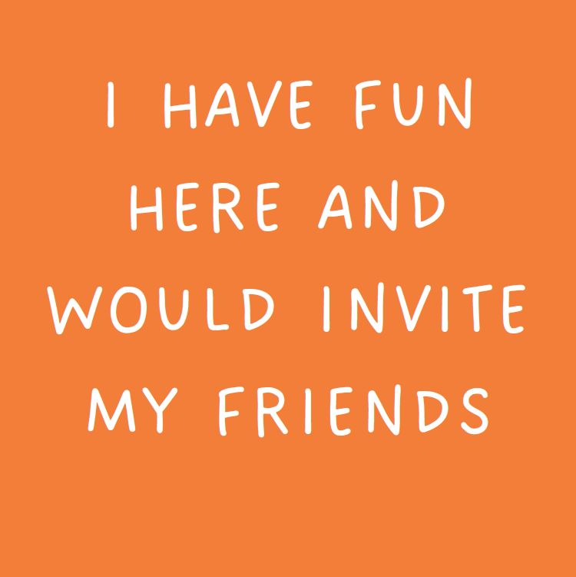
Notes:
This slide has a flattened background, and only includes components that are animated

Slide 7
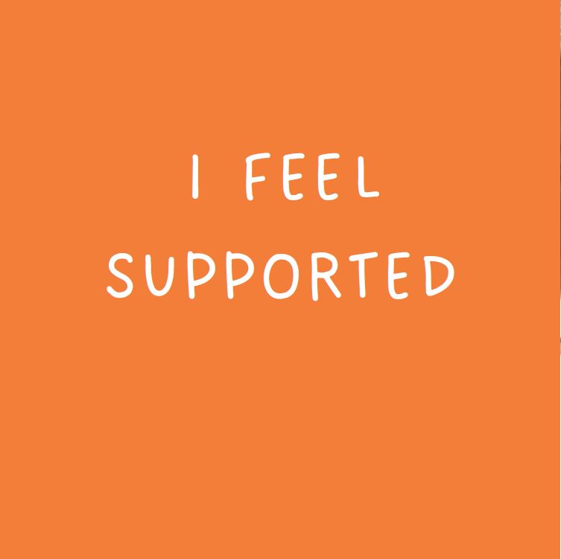
Notes:
This slide has a flattened background, and only includes components that are animated

Slide 8
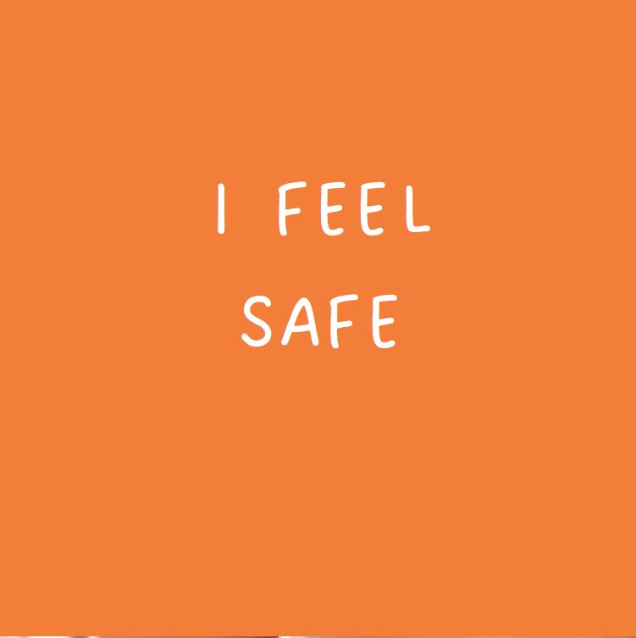
Notes:
This slide has a flattened background, and only includes components that are animated

Slide 9
Notes:
This slide has a flattened background, and only includes components that are animated

Slide 10
Notes:
This slide has a flattened background, and only includes components that are animated

Slide 11
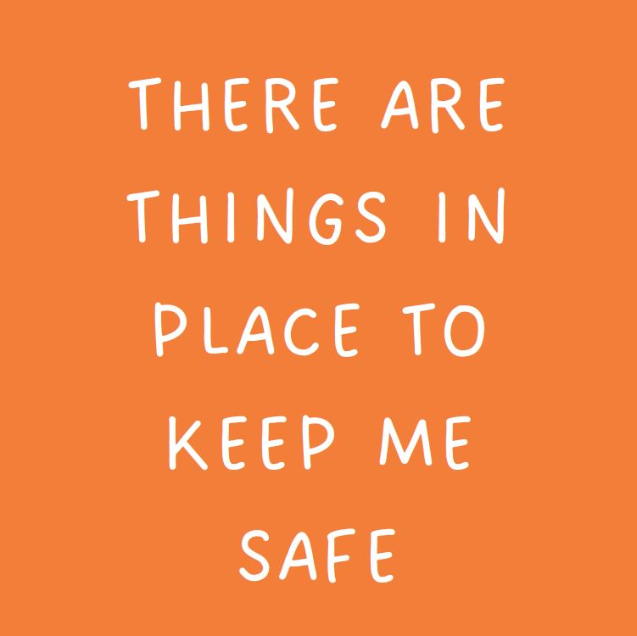
Notes:
This slide has a flattened background, and only includes components that are animated

Slide 12
Is our organisation safe?
Notes:
This slide has a flattened background, and only includes components that are animated

